Slide 1
Applying Antibiotics
Infectious Diseases Elective
7/2022

Slide 2
Overview
Recognition: need for antibiotic
Application: clinical cases
Spectrum of coverage, tissue penetration, resistance
Review of common antibiotic classes
Penicillins, cephalosporins, aminoglycosides, quinolones
Other commonly prescribed drugs
Back to basics (what does the susceptibility mean?)

Slide 3
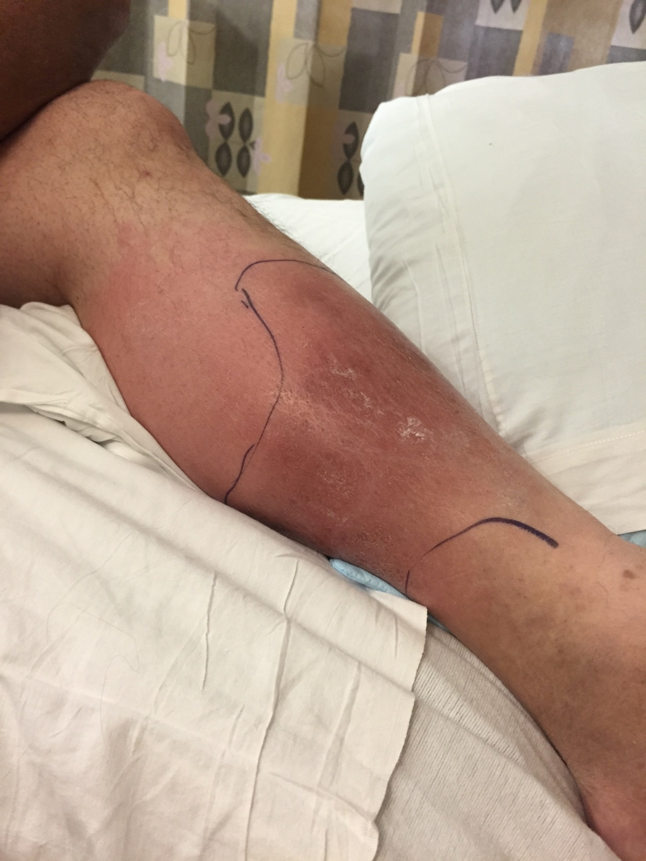
Case 1
44-year-old man presents to ED with pain, erythema L leg
WBC 12.0 with 3% bands
Doppler ultrasound of the lower extremities is negative for deep venous thrombosis

Slide 4
Approach the case
1) Is this patient’s condition an infection?
2) What is your differential diagnosis?
3) Does this patient need antibiotics?
Create a differential diagnosis for an infection using pathogen type…
Bacteria
Virus
Fungus
Parasite

Slide 5
Classes of Antibiotics
Aminoglycosides
Beta-lactams
Penicillins
Aminopenicillins
Ureidopenicillins
Cephalosporins
First generation
Second generation
Third generation
Fourth generation
Fifth generation
Ceftolozane-tazobactam
Ceftazidime-avibactam
Cefiderocol
Carbapenems
Monobactams-Aztreonam
Folate antagonists/sulfonamides
Lincosamides –Clindamycin
Polymyxins-Colistin/polymyxin B
Macrolides
Erythromycin
Azalides
Tetracyclines
Chloramphenicol
Metronidazole
Fidaxomicin
Fluoroquinolones
Pleuromutilin: Lefamulin
Nitrofurantoin/fosfomycin
Glycopeptides/ Lipoglycopeptides -Vancomycin, Telavancin, Dalbavancin, Oritavancin
Streptogramins-Quinupristin/dalfopristin
Oxazolidinone –Linezolid, Tedizolid
Cyclic lipopeptide- Daptomycin

Slide 6
Choosing an antibiotic – First step
Spectrum (What are the likely pathogens?)
Know range of bacteria the agent is effective against
Avoid being TOO broad if feasible
Tissue penetration (does the drug get where you want it to?)
Property of antibiotic (lipid solubility, molecule size)
Property of tissue (blood supply, inflammation)

Slide 7
Next step(s)
Antibiotic resistance (is there resistance amongst pathogens you are considering?)
Inherent or acquired
Safety Profile (what are side effects, is benefit>risk?)
Cost (is there a more cost-conscious alternative?)
Is there a guideline to help you choose?

Slide 8
Our patient: Cellulitis
Spectrum
What are normal flora of the human skin??
Avoid being TOO broad
Probably don’t need gram-negative, Pseudomonas, anaerobe coverage in our patient
Tissue Penetration
Skin and soft tissue
Is there a guideline-based choice?

Slide 9
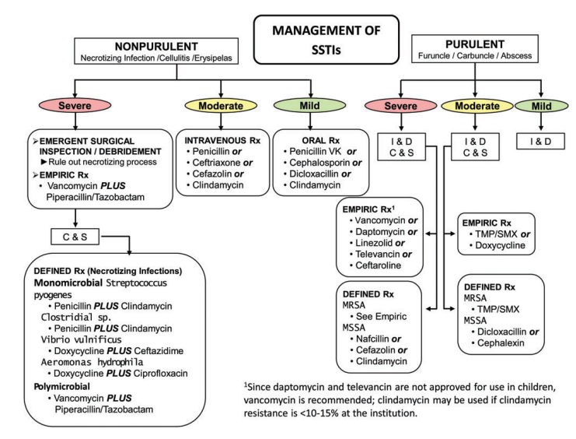
He has non-purulent cellulitis
He has a moderate infection (admitted)
Practice Guidelines for the Diagnosis and Management of Skin and Soft Tissue Infections: 2014 Update by the Infectious Diseases Society of America

Slide 10
Case 1 follow-up
Left leg cellulitis
Non-purulent (differential: Streptococci >> MSSA, MRSA > S. epidermidis)
Severity: moderate, want to penetrate skin/soft tissue – options: cefazolin, ceftriaxone, clindamycin, penicillin
Choice for this patient if hospitalized: cefazolin
Continued clinical improvement and transitioned to oral therapy in 48 hours
Several options; consider oral 1st generation cephalosporin

Slide 11
β-lactams - Penicillins
Penicillins
Aminopenicillins (ampicillin/amoxicillin)
Good for: strep, susceptible enterococci
Common uses: GAS pharyngitis, acute otitis media
Can combine w/b-lactamase: Unasyn, Augmentin
Adds anaerobe coverage; now good for dental infection, bacterial sinusitis
Anti-staphylococcal penicillins (oxacillin/nafcillin/dicloxacillin)
Good for: MSSA, strep, NOT enterococci
Common uses: MSSA infections; watch for interstitial nephritis
Extended spectrum (anti-pseudomonal): piperacillin/tazobactam
Good if you need strep + enterococcus, gram negative including PSAE and anaerobe coverage
Consider: allergy (10% report allergy, 90% of those do not have PCN IgE)

Slide 12
Cephalosporins
Generation 1st 2nd 3rd 4th 5th
S. aureus +++ ++ + + +
MRSA - - - - +
Enterococcus - - - - -
Enteric GNB + ++ +++ +++ +++
Pseudomonas - - ++/-* +++ +++**
Anaerobes - ++/-*** - - -
*Antipseudomonal – Ceftazidime (3rd)
**Ceftolozane-tazobactam, Ceftazidime-avibactam
***Anaerobic - Cefoxitin, Cefotetan (2nd)
♘ Cefiderocol – 4th generation siderophore cephalosporin – MDR infections including Pseudomonas, Enterobacteriaciae, A. baumanii

Slide 13
Carbapenems
Name Ertapenem Imipenem Mero/Doripenem
Gram +s ++ ++ ++
MRSA - - -
Enterococcus - - -
Enteric GNB ++ ++ ++
Pseudomonas - ++ ++
Anaerobes ++ ++ ++
Stenotroph - - -
MDR-Acineto - - -
Imipenem/cilastatin-relebactam
Meropenem-vaborbactam

Slide 14
Monobactam (Aztreonam)
4 member β-lactam ring only
Can use in penicillin-allergic patients
No activity against gram-positives or anaerobes
Binds preferentially to PBP 3 of gram-negative aerobes
E. coli, K. pneumoniae, P. mirabilis, S. marcescens
H. influenzae, M. catarrhalis
Enterobacter, Citrobacter, Providencia, Morganella
Salmonella, Shigella
Pseudomonas aeruginosa (check antibiogram for susceptibility)

Slide 15
Clindamycin
Activity for:
Gram-positive cocci
S. aureus (some MSSA, some MRSA), Streptococcus A, B, C, G including S. pneumoniae
Anaerobes
Good for dental/oral infections and toxin-binding (clostridial infections and in GAS TSS)
Other
Pneumocystis, Toxoplasma gondii, malaria

Slide 16
What if it was purulent?
Purulent cellulitis: more likely staphylococcus
For moderately severe infection:
Vancomycin (glycopeptide)
Can cause acute kidney injury, infusion reaction = red man syndrome (from histamine release – not true allergy); if occurs can slow infusion and pre-medication with tylenol/Benadryl
Other options in class: telavancin, dalbavancin, oritavancin
Linezolid/tedizolid (oxazolidinone) – resistant gram + infections
Can suppress bone marrow, cause neuropathy/serotonin syndrome
Daptomycin (lipopeptide) – resistant gram + infections (not PNA)
Monitor for increased CPK

Slide 17
Case 2
CC: fever/chills
76-year-old male with DM (A1c 6.8), s/p left BKA (due to complicated PVD), CAD s/p CABG in 1994
Started having chills, fever to 102F; symptoms progressed over 3 days and he was admitted to a community hospital for assessment
ROS:
Pertinent positives: anorexia, fatigue
Negative: HA, sinus congestion, rhinorrhea, sore throat, cough, chest pain, n/v/abdominal pain, diarrhea, muscle or joint pains, rash

Slide 18
History
Social/exposure history:
Marital status/area of residence: married, lives w/wife
Job/occupation: retired; works in woodworking in free time
Travel history: none recent, no travel to desert SW or abroad
Animal, bird exposures: outdoor cats on property
Environmental/outdoor/food exposures: water leaking in his workroom, sawdust, moldy wood
Recent ill contacts: no
TB exposure: none
Drugs of abuse: no
Tobacco: former smoker
ETOH: denies

Slide 19
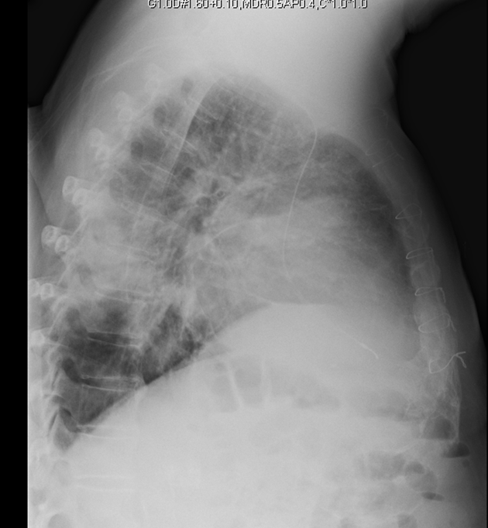
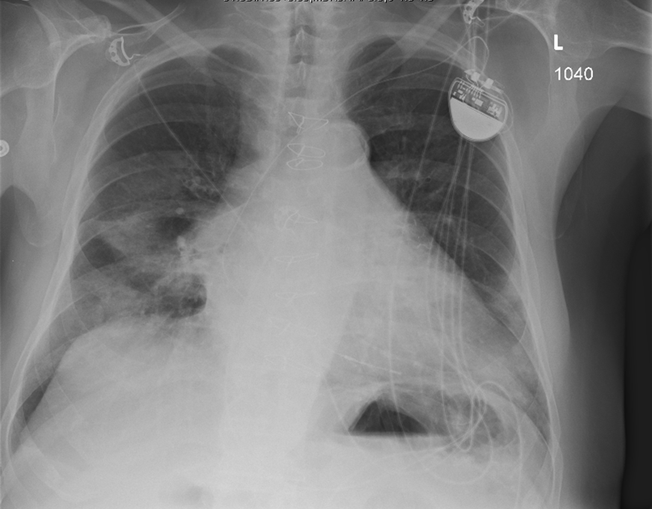

Slide 20
Initial impression
What is your initial assessment?
What is on your differential for pathogens involved?
What antimicrobial therapy would you start?
What other diagnostics would you consider?

Slide 21
Course
Started on empiric antibiotic therapy with ceftriaxone and azithromycin
No improvement symptoms; antibiotic changed to pip/tazo
Still febrile at 48 hours on antibiotics
CT with bilateral pleural effusions – concern for empyema so transferred to tertiary care center on pip/tazo monotherapy
On arrival he was afebrile, VS within normal range
WBC 8.2 w/84% neut, Hgb normal. Na 136, K 4.6, Creat 1.2,
Transaminases were normal though bilirubin 2.3.
UA was unremarkable.

Slide 22
Further workup?
From community hospital
– blood cultures were negative from admit
– sputum culture was unable to be obtained
What other diagnostics would you consider?
What if anything would you change for antimicrobial coverage?
Legionella urine ag returned positive

Slide 23
Community-acquired pneumonia
Spectrum (What is your likely pathogen?)
Streptococcus pneumoniae, H. influenzae, Mycoplasma pneumoniae, Chlamydophila pneumoniae, Legionella
Want to avoid being TOO broad
Probably don’t need ESBL, Pseudomonas, anaerobe coverage
Appropriate site of action (does the drug get where you want it to?)
Lung → no daptomycin (inactivated by surfactant)

Slide 24
Next Steps in Choosing an Antibiotic
Antibiotic resistance
Inherent or acquired
Genetic variability:
Microevolutionary: point mutations
Macroevolutionary: inversions, duplications, insertions, deletions, or transposition of large sequences of DNA from one location of a bacterial chromosome or plasmid to another (transposons or insertion sequences)
Acquisition of foreign DNA carried by plasmids, bacteriophages, or transposable genetic elements
Pharmacodynamics/pharmacokinetics
Safety profile & cost
Is there a guideline-based choice?

Slide 25
Our armamentarium (CAP)
β-lactams
Penicillins
Aminopenicillins
Cephalosporins
Third generation
4th generation
5th generation
Macrolides
Azithromycin
Clarithromycin
Erythromycin
Tetracyclines
Doxycycline
Minocycline
Fluoroquinolones
Levofloxacin
Moxifloxacin
Ciprofloxacin
Delafloxacin

Slide 26
IDSA guidelines for CAP treatment
Admitted to the Floor:
Anti-pneumococcal β-lactam (Cefotaxime, Cetriaxone, Amp-sulbactam, Ertapenem) + macrolide (or doxycycline)
OR: Respiratory fluoroquinolone (Levaquin or moxifloxacin)
Admitted to the ICU (severe CAP):
Anti-pneumococcal β-lactam (Cefotaxime, Cetriaxone, Amp-sulbactam, Ertapenem) + macrolide (or doxycycline)
OR: Anti-pneumococcal β-lactam (Cefotaxime, Cetriaxone, Amp-sulbactam, Ertapenem) + resp fluoroquinolone (moxifloxacin or levaquin)
OR: For Penicillin allergic patients – respiratory fluoroquinolone (moxifloxacin or Levaquin) + aztreonam
Prior PSAE colonization or chronic lung disease:
Anti-pneumococcal and anti-pseudomonal β-lactam (pip/tazo, cefepime, meropenem, imipenem) + ciprofloxacin or Levaquin; *n some cases, an aminoglycoside may need to be added
For PCN-allergic patients, substitute aztreonam for the β-lactam
If CA-MRSA is a concern:
Add IV vancomycin or linezolid , or use Ceftaroline + atypical coverage
https://www.idsociety.org/practice-guideline/community-acquired-pneumonia-cap-in-adults/

Slide 27
Macrolides
Azithromycin, Clarithromycin, Erythromycin
Good activity against CAP pathogens
Atypical: Chlamydia spp., Mycoplasma spp., Legionella
Typical: S. pneumo, MSSA, upper airway anaerobes
Azithro/clarithro: MAI (Mycobacterium avium intracellulare) and other non-tuberculous mycobacteria
Other uses
Treponema pallidum (but high resistance known), Campylobacter, Borrelia, Bordetella, Brucella, Pasteurella

Slide 28
Tetracyclines
Doxycycline
Potential uses
Community-acquired respiratory tract infections (atypicals, S. pneumo)
Skin/soft tissue infections (staph)
Chlamydia
Tick-borne infections
(Lyme, RMSF, Ehrlichia, Tularemia)
Helicobacter pylori
Minocycline
Oral therapy for MRSA, activity for some Stenotrophomonas, used to treat acne
Watch for: phototoxicity, discoloration of teeth and skin

Slide 29
Fluoroquinolones
Only oral therapy option for some Pseudomonas infections
Anaerobic potential (moxifloxacin)
Atypical Bacteria –
Legionella, Chlamydia spp. Mycoplasma spp., Ureaplasma urealyticum
Delafloxacin – approved for skin/soft tissue (active for MRSA)
Potential adverse reactions/toxicities
QTc prolongation-Torsades de Point (not reported for delaflox)
Arthropathy – more in older adults
Tendon rupture- any quinolone, less for delaflox

Slide 30
Case 3
CC: neutropenic fever
An 18-year-old male was inpatient on the bone marrow transplant service. He had been diagnosed via bone-marrow biopsy of T-cell ALL with high-risk cytogenetics. He underwent induction chemotherapy, consolidation therapy then myeloablative umbilical cord transplant 8 days ago.
On day 8 post transplant, he was neutropenic and developed fever of 39.1°C

Slide 31
Case 3
Day +8:
T: 39.1°C, RR: 22, BP: 110/65, O2 sat: 96% RA
Exam: petechiae on lower legs, trifusion catheter R chest wall non-tender with no erythema. He had L>R bibasilar crackles.
Lab: WBC 0.1, hgb 8.5g, plt 22,000
A CT chest is ordered to evaluate the lower lobe crackles.
Patient needs empiric antibiotic therapy for neutropenic fever.

Slide 32
Choosing your Drug
Spectrum
Appropriate site of action
Antibiotic Resistance
Pharmacodynamics/pharmacokinetics (this patient has no host immune defense– needs bacteriocidal drug that will kill pathogen independently)
Safety profile & cost
*What would you choose and why?

Slide 33
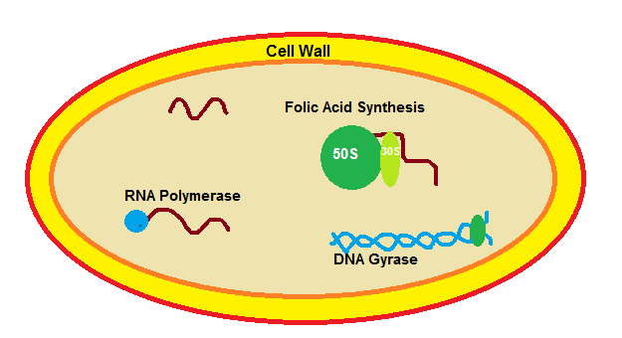
Antibiotic Mechanisms of Action
Cell Wall Synthesis
Peptidoglycan-synthesis: Vanco
Peptidoglycan-cross-link: b-lactams
Penicillins
Aminopenicillins
Anti-staph PCNs
Ext-spectrum
Cephalosporins
First generation
Second generation
Third generation
Fourth generation
Fifth generation
Ceph+β-lactamase inhibitors
Carbapenems
Carba+β-lactamase inhibitors
Monobactam-Aztreonam
Folic Acid Synthesis
Sulfonamides
50S ribosomal subunit
Macrolides
Erythromycin
Azalides
Ketolides
Clindamycin
30S ribosomal subunit
Tetracyclines
Minocycline
Doxycycline
Aminoglycosides
Tobramycin
Gentamicin
Amikacin
Cell Membrane Function
Daptomycin
Colistin
RNA Polymerase
Rifampin
DNA integrity (free radicals)
Metronidazole
DNA Synthesis
Fluoroquinolones

Slide 34
Bactericidal: kills bacteria –
Can eradicate pathogen in the absence of host immune defense mechanisms
Bacteriostatic: inhibits bacteria-
Requires host immune defense mechanisms to eradicate the infection
Cefepime
In general, cell wall - active agents are bactericidal and drugs inhibiting protein synthesis are bacteriostatic
*Some bactericidal drugs may be bacteriostatic to certain organisms

Slide 35
Bacteriocidal vs. static
Cell Wall Synthesis
Peptidoglycan-synthesis: Vanco
Peptidoglycan-cross-link: b-lactams
Penicillins
Aminopenicillins
Anti-staph PCNs
Ext-spectrum
Cephalosporins
First generation
Second generation
Third generation
Fourth generation
Fifth generation
Ceph+β-lactamase inhibitors
Carbapenems
Carba+β-lactamase inhibitors
Monobactam-Aztreonam
Folic Acid Synthesis
Sulfonamides
Folic Acid Synthesis
Trimethoprim/Sulfa
50S ribosomal subunit
Macrolides
Erythromycin
Azalides
Ketolides
Clindamycin
30S ribosomal subunit
Tetracyclines
Minocycline
Doxycycline
Aminoglycosides
Tobramycin
Gentamicin
Amikacin
Cell Membrane Function
Daptomycin
Colistin
RNA Polymerase
Rifampin
DNA integrity (free radicals)
Metronidazole
DNA Synthesis
Fluoroquinolones

Slide 36
Bacteriocidal vs. static
Bacteriocidal drugs – use in:
Neutropenia, severely compromised immune system
Life-threatening infections (bacteremia, endocarditis, meningitis, brain abscess)

Slide 37
Case 4
CC: fever
A 22-year-old male sustained polytrauma from MVA including multiple broken bones, closed head injury and chest contusions. He has been in ICU for 25 days with fever of 38-39°C x 6 days
4 days ago he was started on daptomycin for suspected central line infection
2 days ago Cefepime & levofloxacin were added for possible health-care acquired pneumonia

Slide 38
Case 4
Despite this addition, over the past 24 hours he has developed increased WBC from 13→17K, hypotension requiring Norepinephrine, increased sputum production and diffuse muscle aches.
Why might he now be developing septic shock?
What organisms are not covered by his current regimen?
What would you consider changing?
Could he be having an adverse antibiotic reaction?

Slide 39
Daptomycin
Lipopeptide; active only for gram positive bacteria
Staph (including MRSA), Strep (also including VRE – E. faecalis, E. faecium)
Gram positive anaerobes – Peptostreptococcus
Bactericidal
Indicated for bacteremia and right sided endocarditis
Not indicated for pneumonia…why?
Increase in serum creatinine phosphokinase (CPK) and may cause myalgias, myopathy
Given once daily to reduce muscle toxicity
Need close monitoring of CPK

Slide 40
Vancomycin
Glycopeptide; no gram-negative coverage
Gram-positives
MSSA, MRSA, CoNS
S. pneumoniae, groups A, B, C, D strep, Enterococcus
Corynebacterium, Bacillus, Listeria, Actinomyces
C. difficile (if given orally)
Side effects:
Red man syndrome (not an allergy – is due to histamine release), phlebitis
Nephrotoxicity – monitor drug levels to adjust dosing

Slide 41
Case 4, cont.
His sputum gram stain shows gram positive cocci in clusters
You stop Daptomycin and switch to Vancomycin while awaiting cultures
Sputum grows MRSA and you discontinue the Cefepime and levofloxacin
Over the next 48 hours he develops acute kidney injury
What other agent may be useful in this case?

Slide 42
Linezolid
Oxazolidinone; no gram negative coverage
Gram positive
MRSA, CoNS, drug resistant Streptococcus pneumoniae (DRSP), VRE (E. faecalis and E. faecium)
Bacteriostatic
Reactions:
Cytopenias
Optic neuropathy (particularly if used > 2 wks)
Price tag shock

Slide 43
Clinical Case
What if instead, the sputum was growing Pseudomonas aeruginosa?
What treatment options do you have?

Slide 44
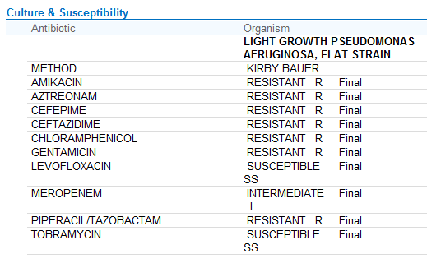
Antibiotic susceptibility ex. PSAE

Slide 45
Tailoring your therapy
Adjust any coverage based on susceptibilities
Did you identify a resistant pathogen?
Safety profile & cost
Would you choose levofloxacin or tobramycin?
Narrow your coverage
If he would have been started on Vancomycin, cefepime and tobramycin for HAP, could we stop any of the agents OR change a broad-spectrum agent to a narrower spectrum agent?

Slide 46
Aminoglycosides
Tobramycin
Most potent for Pseudomonas aeruginosa
Gentamicin
Most commonly used of this class for GNR
Used for synergy in Enterococcus bacterial endocarditis
Amikacin
Least likely for resistance to occur from inactivating enzymes
Useful also for mycobacterial infection
Dosing:
Hartford nomogram (use a reference)
Extended interval (Zaske kinetics – use a reference)

Slide 47
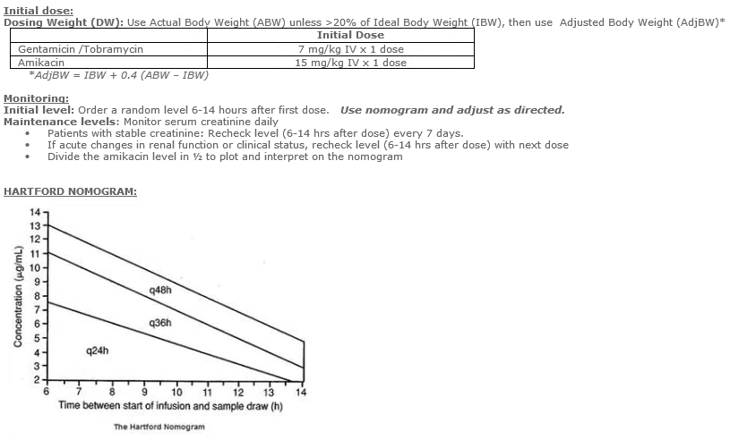

Slide 48
Aminoglycosides vs. quinolones when concerned about PSAE
Benefits of quinolones:
Less oto and nephrotoxicity
No need to monitor levels
Can start or convert to oral therapy
Benefits of aminoglycosides:
More potent for PSAE by 15-20% - less likely acquired resistance
Usually broader coverage for health-care acquired (resistant) organisms

Slide 49
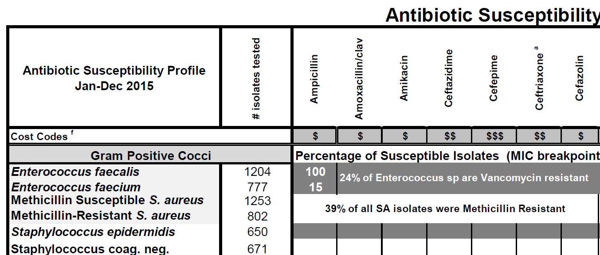
What’s an antibiogram and how can it help?
A Hospital antibiogram is a summary of antimicrobial susceptibilities of local bacterial isolates submitted to the hospital's clinical microbiology laboratory in a given time period
They can be used by clinicians to assess local susceptibility rates, to aid in selecting empiric antibiotic therapy, and to monitor resistance trends

Slide 50
Last case
81-year-old diabetic female presents to her PCP via her daughter with urinary frequency, fever of 101°F x 2 days and confusion
She appears ill, is tachycardic at 110 BPM and is admitted
A UA demonstrates pyuria and a serum WBC is 13k
Blood cultures are drawn, a urine culture is sent
What antibiotic will you start empirically?
Review some steps you would consider in your decision

Slide 51
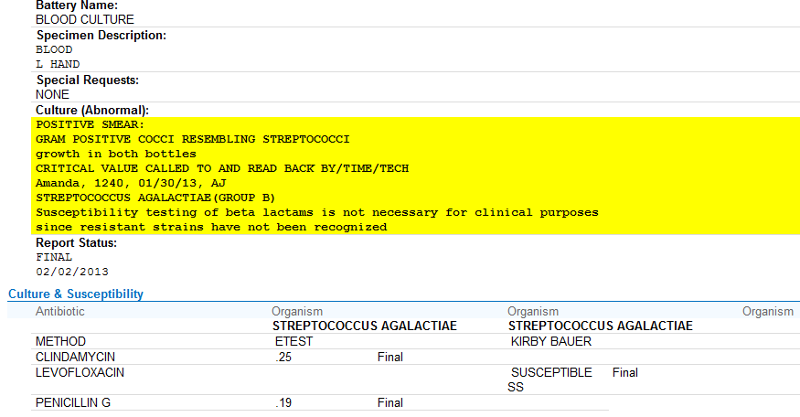
Case 5, culture result
Can we switch to PCN G?

Slide 52
Back to the basics – interpret susceptibility
Kirby bauer: (disk diffusion antibiotic sensitivity testing) uses antibx-impregnated wafers to test whether bacteria are susceptible to specific antibiotics (does not give MIC (S/IS/R)
Etest: provides Minimum Inhibitory Concentrations (MICs) for slow-growing organisms and those not usually tested by automated methods
Minimum Inhibitory Concentrations (MICs): how we usually determine if an organism is “susceptible” to an antibiotic (micro broth dilution)
Mix standard concentration of organism with increasing antibiotic concentration in a test tube or on a plate

Slide 53
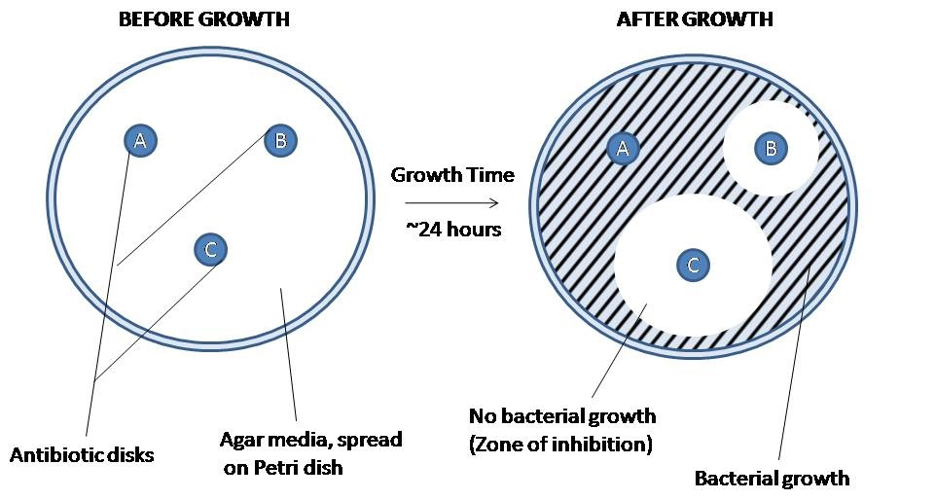
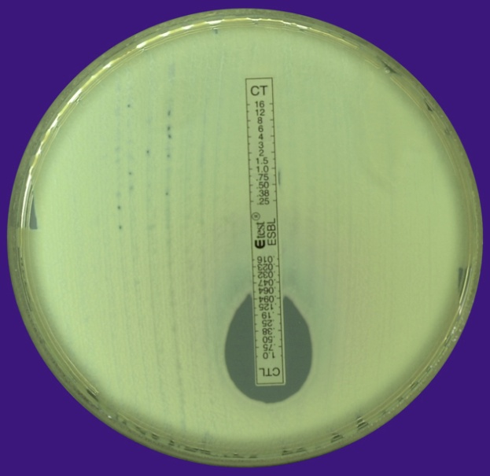
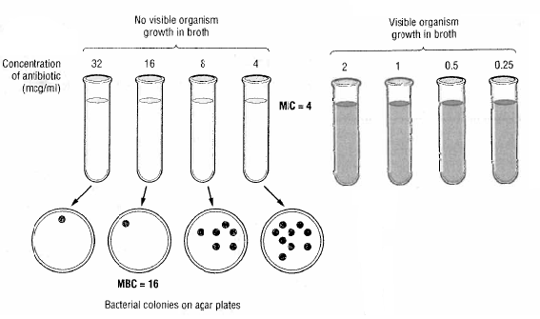
E test = Measure here
Disc diffusion method
Best method = MIC

Slide 54
Case follow-up
Blood cultures starting hospital day 3 are negative
After volume resuscitation and on day 4 of hospitalization her delirium is significantly improved
MIC
PCN G | <0.12 | highly susceptible
(S. agalactiae MIC = 0.19) | 0.12-0.5 | intermediate
 | >0.5 | resistant

Slide 55
Summary
Recognition: does the patient need an antibiotic?
How do we choose?
Consider spectrum, tissue penetration, resistance, safety, bacteriocidal vs. static
Common antibiotic classes
Keep in mind coverage for common classes: penicillins, cephalosporins, aminoglycosides, quinolones
Understand how to interpret susceptibility (don’t forget to keep in context of the clinical case)

Slide 56
Individual Readiness Assessment Test
A patient presents with mild non-purulent cellulitis of the left leg. What oral antibiotic do you recommend?
A patient presents with moderately severe purulent cellulitis and associated abscess of the thigh. What IV antibiotic do you recommend?
A patient is admitted with community-acquired pneumonia to a floor bed. What pathogens are you presumably covering for?
You are consulted on a patient with new VAP in the SICU. What empiric antibiotic coverage do you recommend?
What nomogram can you use to help you dose aminoglycosides?
What general class of pathogen(s) coverage is aztreonam missing?
If you are using cefepime and vancomycin for a patient hospitalized for > 48 hours with new HAP, what coverage should you add if aspiration becomes a concern?
What is an MIC?
Penicillin, cephalexin, dicloxacillin or clindamycin
Vancomycin, daptomycin, linezolid, telavancin or ceftaroline
S. pneumoniae, legionella, mycoplasma, chlamydia
Cefepime or Pip/tazo or meropenem/imipenem + vancomycin or linezolid (+/- an aminoglycoside if there is high % PSAE resistance to your primary GN choice of therapy)
Hartford
Gram-positive and anaerobe
Anaerobe (need clindamycin or metronidazole)
Method of determining if an organism is “susceptible” to an antibiotic (micro broth dilution). You mix a standard concentration of organism with increasing antibiotic concentration in a test tube or on a plate. The level with no visible growth is the MIC.

