Slide 1
HIV
Infectious Diseases Elective

Slide 2
Overview
Definitions/recognition
Acute retroviral syndrome
Transmission
Pathogenesis
Diagnosis
Antiretroviral therapy
High yield opportunistic infections
PrEP
Post-module readiness test

Slide 3
HIV-1, HIV-2
>38 million people worldwide infected
HIV-2 is much less common than HIV-1 (primarily in Africa)
New infection -> acute retroviral syndrome (not everyone has symptoms when infected or often they cannot recall symptoms)
When HIV is left untreated it usually progresses to AIDS (CD4 <200 or HIV + an opportunistic infection/related malignancy)
Per CDC: TEST all persons age 13-64 for HIV at least once!!
https://www.hiv.gov/hiv-basics/overview/data-and-trends/global-statistics#:~:text=According%20to%20UNAIDS%20%3A,(%3C15%20years%20old).

Slide 4
Elite Controllers
A small percentage of people with HIV infection will maintain CD4 counts with VL ND without ARV treatment (elite controllers)
HIV is still replicating so ART is recommended if there are declines in CD4 or complications from HIV
https://clinicalinfo.hiv.gov/en/glossary/elite-controllers

Slide 5
A 19-year-old man presents to urgent care with fever, sore throat, headache and rash for several days. On exam he has no tonsillar exudate but does have bilateral cervical adenopathy. A rapid strep test and mono spot are negative. Upon further questioning he endorses having unprotected sexual intercourse (not always using condoms). He denies tobacco or recreational drug use. What testing would you want to evaluate for acute HIV infection?
HIV Ag/Ab
HIV Ab
HIV RNA NAAT (viral load)
Rapid HIV EIA on oral fluid
Notes:
3-8 days for p24 + after infection
RNA about 10 days after infection
AB + after about 22 days

Slide 6
Acute retroviral syndrome
Onset within a few weeks of acquiring infection; symptoms similar to mononucleosis syndrome
Sign/symptom | Frequency
Fever | 96%
Lymphadenopathy | 74%
Pharyngitis | 70%
Rash | 70%
Myalgia/arthralgia | 54%
Diarrhea | 32%
Headache | 32%
Nausea/vomiting | 27%

Slide 7
Transmission
Risk of HIV transmission is determined by:
Infectivity and volume of body fluid
Known infectious
Blood, semen, vaginal fluid, breast milk
Potentially infectious
Pericardial, synovial, peritoneal, CSF, pleural, amniotic
Nature of exposure (sexual, percutaneous)
Amount of viable virus
Treatment = prevention: if a patient has a non-detectable HIV VL it is very unlikely they will transmit HIV infection

Slide 8
Rate of infection per 10,000 exposures
Activity | Risk per 10,000 exposures
Receipt of HIV infected blood transfusion | 9250
Needle-sharing injection-drug use | 63
Receptive anal intercourse | 138
Receptive vaginal intercourse | 8
Insertive anal intercourse | 11
Insertive vaginal intercourse | 4
Receptive/insertive oral intercourse | Low
Percutaneous (needle stick, scalpel injury) | 23
https://www.cdc.gov/hiv/risk/estimates/riskbehaviors.html

Slide 9
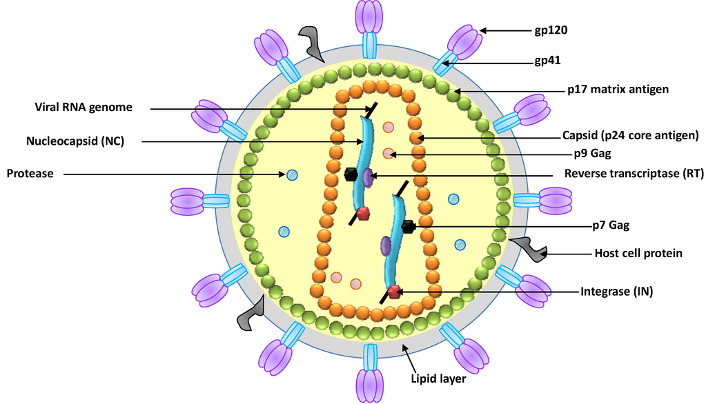
Structure of HIV-1
(envelope proteins)
Ag in 4th gen test
https://www.mdpi.com/1424-8247/6/12/1507/htm

Slide 10
Viral attachment
HIV-1 envelope protein gp120 binds our CD4 receptor
Changes shape of gp120 to expose the co-receptor binding site
gp120 binds to co-receptor
gp 120 changes shape again and envelope protein gp41 then exposes a fusion peptide that fuses with the CD4 cell membrane
this draws the two membranes together for fusion
Then viral RNA and proteins can enter the CD4 cell
Co-receptor can be CCR5, CXCR4 or BOTH
Can look for which receptor a virus has with “tropism test”
Necessary to use the CCR5 antagonist “Maraviroc” which only blocks R5 viruses

Slide 11
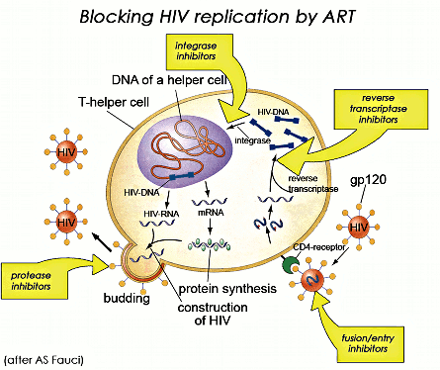
The replication cycle of HIV
https://www.youtube.com/watch?v=odRyv7V8LAE
http://www.shinewomen.co.uk/hiv

Slide 12
Pathogenesis – initial transmission
HIV fuses with then infects CD4+ T-cells
Within 48 to 72 hours, HIV can spread to local inguinal lymph nodes
Systemic viremia typically occurs around day 10: sore throat, fever, rash (acute retroviral syndrome)
Followed by extensive seeding of lymphoid organs (including gut) & CNS

Slide 13
Reverse transcription & Resistance
RT occurs in the cytoplasm
No proof reading capability = lots of mutations!
One point mutation with each new copy of viral DNA
Each of the 10,000 nucleotides in the genome becomes mutated somewhere in the body at least once per day
A single drug for HIV will always fail. Two drugs are effective in the right circumstance. Three active drugs work.
The chance of 3 different drug resistance mutations arising in the same viral genome is low enough

Slide 14
Case
A 20-year-old man comes to clinic to establish care for HIV
Past medical/surgical history: none
Social history: no tob/ETOH/IVDA. Sexually active with 1 male partner; uses condoms infrequently

Slide 15
Initial HIV Evaluation
History
HIV risk factors
Prior HIV testing
Other co-morbidities
Mental health
Prior STD
Smoking, recreational drugs
Risk for adherence issues
Medication interaction
Lab
Confirm diagnosis (4th generation test = HIV Ag/Ab = 99.6% sensitive)
HIV VL
CD4 count
HIV genotype
Hepatitis screening
CBC, CMP, UA, lipids, PAP
STD screening
Toxo, CMV IgG, Tspot
Consider HLA-b5701 if abacavir will be considered

Slide 16
Initial Labs
CBC: normal
CMP: normal
UA, lipids: normal; TB Tspot: negative
Toxoplasma and CMV IgG +
Hep A IgG, Hep B surface Ag/surface Ab positive (immune)
CD4 432 cells (22%)
VL: 58,000 copies/mL

Slide 17
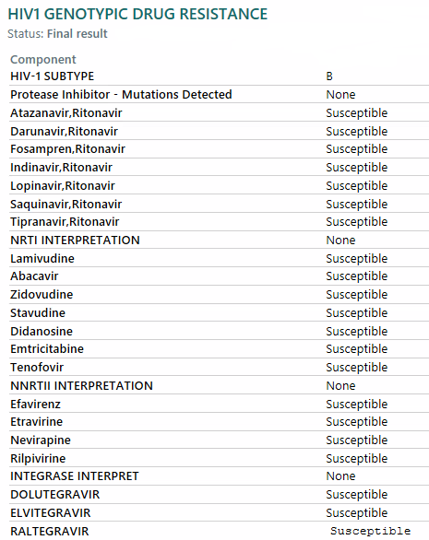

Slide 18
Clinical info: hiv.gov recommended initial therapy for naïve patient
Bictegravir/tenofovir alafenamide/emtricitabine
Dolutegravir/abacavir/lamivudine—only for individuals who are HLA-B*5701 negative and without chronic hepatitis B virus (HBV) coinfection
Dolutegravir plus (emtricitabine or lamivudine) plus (tenofovir alafenamide or tenofovir disoproxil fumarate)
Dolutegravir/lamivudine—except for individuals with HIV RNA >500,000 copies/mL, HBV co-infection, or in whom ART is to be started before the results of HIV genotypic resistance testing for reverse transcriptase or HBV testing are available
https://clinicalinfo.hiv.gov/en/guidelines/adult-and-adolescent-arv/whats-new-guidelines

Slide 19
Patient is started on biktarvy (bictegravir, emtricitabine, tenofovir alafenamide) which he tolerates well
VL 2-8 weeks after initiation of therapy
CMP 2-8 weeks after starting therapy
After ~3 months (then every 3-6 months) CBC, CD4 count (for 1st 2 years) VL, CMP
https://clinicalinfo.hiv.gov/en/guidelines/adult-and-adolescent-arv/what-start-initial-combination-regimens-antiretroviral-naive?view=full

Slide 20
Common ARV class side effects

Slide 21
Opportunistic infections
Prevention and Treatment in HIV/AIDS

Slide 22
Opportunistic infection prophylaxis?

Slide 23
OI prophylaxis
PJP: CD4 < 200 Bactrim DS 1 tab 3x/wk or daily
MAC: CD4 < 50 azithromycin 1200 mg weekly if not immediately starting ARV
If started can be discontinued once the individual begins ART

Slide 24
Case
CC: Shortness of breath
27-year-old woman with HIV
3 weeks shortness of breath
Initially noted going upstairs but more recently has been having SOB with minimal activity
1-2 weeks of non-productive cough and intermittent fevers to 39⁰C
Moderate-severe headache which have worsened over the past few days
Exam: no meningismus, lung exam unremarkable

Slide 25
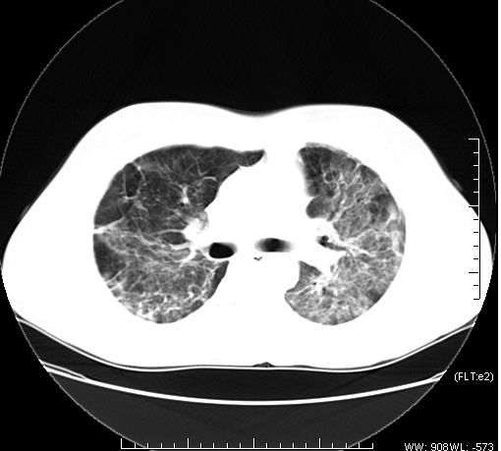
CD4 comes back at 50cells/mL What is the most likely diagnosis?
CT CHEST

Slide 26
Clinical Presentation of Pneumocystis Pneumonia
The classic presenting triad:
Fever (79-100%)
Exertional dyspnea (95%)- desaturation w/ walking (progressive over weeks)
Nonproductive cough (95%)
Other common presenting features (nonspecific):
Fatigue
Chills
Headache
Chest pain
Weight loss
Hypoxemia
Elevated LDH

Slide 27
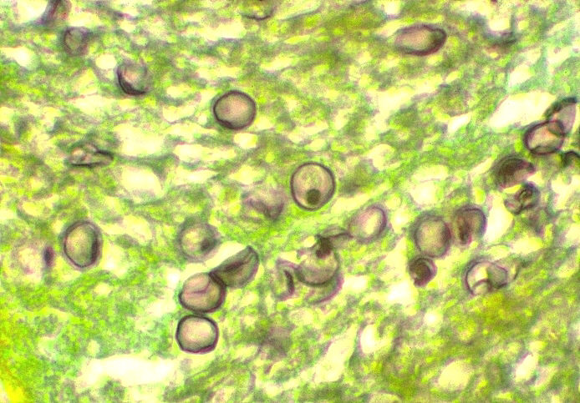
Diagnosis of PCP
Induced Sputum and BAL cytology
Yield of stained specimen:
Induced sputum : 50% to 90%
Bronchoscopy with BAL : 90%-99%
Transbronchial biopsy: 95%-100%
Open lung biopsy: 95%-100%
PCR
From induced sputum and BAL
Sensitivity 81%-100%
Specificity 86%-100%
PCR from oropharyngeal washings and serum
Not shown to be useful
Gomori Methenamine Silver Stain
Notes:
GMS stains the cyst wall

Slide 28
Treatment of PCP (21 days)
Drug | Dose | Route | Comments
TMP / SMX (Bactrim) | 15-20 mg/kg/d TMP component divided q 8hr | PO/ IV | First choice
Primaquin + Clindamycin | 30 mg PO daily + 600-900 IV q 8h (600 mg po tid for less severe) | PO/IV | Alternate choice
Pentamidine | 4mg/kg or 600 mg | IV | Alternate choice
Atovaquone | 750 mg bid | PO | Alternate choice for less severe
Dapsone/TMP | 100mg + TMP 15mg/kg/day 3 divided doses |  | Alternative choice for less severe
Notes:
Mutations associated with resistance to sulfa drugs have been documented, but their effect on clinical outcome is uncertain.73-76 Patients who have PCP despite TMP-SMX prophylaxis usually can be treated effectively with standard doses of TMP-SMX

Slide 29
Role of Steroids in PCP
Indicated for Pa 0₂ <70 or A-a grad >35 mm Hg
Should begin ASAP within 72 hrs of PCP therapy
Also consider with progression of the disease even if they do not meet the above criteria
Prednisone :
40 mg PO bid x 5 days (d 1-5)
40 mg PO QD x 5 days (d 6-10)
20 mg PO daily x 11days (d 11-21)
Caution: Other OIs can initially respond to steroids (i.e. TB, Histo)
As a general rule, if patients receive steroids, the diagnosis should be confirmed with sputum/bronch

Slide 30
Case
CC: headache
42-year-old man with HIV, low adherence with ARV
Roommate brings him to ER noting 2 weeks of progressive headache
Sleeping more, has been taking Tylenol and ibuprofen prn without significant improvement
Patient reports intermittent fever and chills
Exam: no meningismus, oriented to person/place

Slide 31
Cryptococcosis
Most infections occur in newly diagnosed patients with CD4 < 100
Asymptomatic antigenemia can predate clinical infection
Meningoencephalitis is the most frequent presenting manifestation
Acute, sub acute or chronic meningitis
Cryptococcoma of brain (abscess)
Symptoms
Indolent over 1-2 wks
Fever
Headache
Myalgias
Stiff neck and photophobia (< 1/3 of pts)
Mental status changes/focal neurologic deficits
Visual/hearing loss

Slide 32
Diagnosis
CSF analysis
All patients should have LP regardless of symptoms
Opening pressure is elevated in up to 75% cases
Cryptococcal antigen (Ag) titer
Highly sensitive 93%-100% and specific 93% -95%
Blood culture
Positive in as many as 65%
CSF culture
Serum Cryptococcal Ag
Similar sensitivity to CSF Ag in AIDS
Does not correlate with treatment response

Slide 33
Treatment
Induction therapy:
Amphotericin and Flucytosine (100mg/d divided qid) for at least 2 weeks*
Repeat LP
Should follow opening pressure closely- may need multiple repeat LP for elevated ICP
Consolidation therapy:
Fluconazole 400 mg for 8 wks or until CSF cultures are sterile
Maintenance therapy:
Fluconazole 200mg
Could consider discontinuing after 12 months of chronic maintenance therapy if CD4 > 100cells/ul for > 3month
Delay initiation of ART until after completion of antifungal induction therapy (the first 2 weeks) and possibly until the total induction/consolidation phase (10 weeks) has been completed
Risk: IRIS
*https://www.nejm.org/doi/full/10.1056/NEJMoa2111904
Notes:
Repeat LP
Should follow opening pressure closely- may need multiple repeat LP for elevated ICP- general rule- remove 20-30 cc or enough to half OP
Document negative cultures prior to transitioning to oral therapy-positive cultures post 2 weeks predicts complications and decreased outcome
*Single-dose liposomal amphotericin B combined with flucytosine and fluconazole was noninferior to the WHO-recommended treatment for HIV-associated cryptococcal meningitis and was associated with fewer adverse events

Slide 34
Case
CC: confusion
38-year-old woman with HIV
Family brings her in noting she has not been acting like herself for 2-3 weeks
Confused at times, forgetful, unsteady gait and generalized weakness
Low grade intermittent fever
Exam: no meningismus

Slide 35
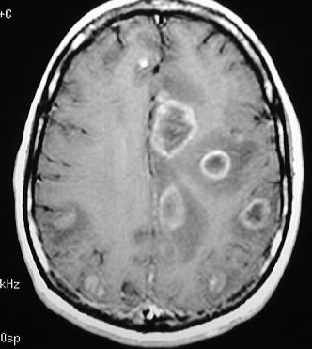
MRI brain

Slide 36
CNS Toxoplasmosis
In pts with CD4 <100, positive Toxo IgG, not on OI prophylaxis who present with multiple ring enhancing lesions the likelihood of having Toxo is high (0.87)
Empiric treatment for Toxo is started
Respond quickly with clinical and radiographic improvement within two weeks
If no improvement further diagnostic testing done (i.e. lesion biopsy)
Diagnostic testing should be performed initially if:
Higher CD4, on prophylaxis, negative toxo titer or typical MRI findings
Main differential would be CNS lymphoma

Slide 37
CNS Toxo - Diagnosis
CSF
Mild mononuclear pleocytosis and elevated protein
PCR sensitivity only ~ 50%, specificity is high
MRI is more sensitive than CT in diagnosis
MRI should be obtained if a single lesion is seen
SPECT/PET
Can be useful in distinguishing between Toxo and Lymphoma/other CNS infections
Lymphoma has more Thallium uptake on SPECT and greater glucose uptake in PET
Brain biopsy may help in definitive diagnosis but associated with high morbidity and even mortality

Slide 38
Treatment Of CNS Toxoplasmosis
First line:
Pyrimethamine + sulfadiazine + leucovorin
Second line:
Pyrimethamine + clindamycin + leucovorin
Acute Tx is for at least 6 wks
Longer if lesions extensive or slow to progress
Secondary prophylaxis
Pyrimethamine + sulfadiazine + leucovorin
Can be dc’d after 6 months If CD4 count >200 , brain lesions are resolved and neurologically stable

Slide 39
PrEP (Pre-exposure prophylaxis)
Consider for those at risk of acquiring HIV:
HIV negative and in an ongoing sexual relationship with partner with HIV
If they have had penile-anal/penile-vaginal sex without a condom in the past 6 months with >1 partner or been diagnosed with an STD in the past 6 months
Heterosexual men / women who are not in a monogamous relationship with an HIV-negative partner, and who do not always use condoms during sex with partners whose HIV status is unknown/w/high risk
Use of IV drugs/shared needles, or any drug use during sex
And if no barriers to taking daily meds/no contraindication to below
Truvada (tenofovir disoproxil fumarate/emtricitabine) OR Descovy (tenofovir alafenamide/emtricitabine)
Per CDC: by taking PrEP every day, a person can lower risk of getting HIV from sex up to 99% and from IVDA > 70%
Descovy not yet approved for IVDA or receptive vaginal intercourse risk but may be appropriate
Need baseline HIV test, creatinine, hepatitis screening + every 3 month HIV screen + VL and STD screens
Every 12 mo creatinine, lipid and weight assessment, Hep C screen
Hare B, Coll P, Ruane P, et al. The Phase 3 DISCOVER Study: Daily F/TAF or F/TDF For HIV Pre-Exposure Prophylaxis. Presented at The annual Conference on Retroviruses and Opportunistic Infections (CROI). Seattle. 2019.
Sci Transl Med. 2012 Sep 12;4(151):151ra125. doi: 10.1126/scitranslmed.3004006.
https://www.cdc.gov/hiv/basics/prep.html

Slide 40
Key points
Definitions/recognition
AIDS = CD4<200 or HIV + AIDS-defining condition (OI/AIDS-related cancer)
Don’t forget acute retroviral syndrome (symptomatic new infection – watch for a mono-like illness and check HIV VL)
Diagnosis
Acute = PCR, Standard: 4th Gen HIV Ag/Ab
Antiretroviral therapy (usually 3 active drugs)
Opportunistic infections (PJP, Toxo, Cryptococcus)
Consider PrEP for at-risk patients

Slide 41
Individual Readiness Assurance Test
Per the CDC, who should get tested for HIV?
List 3 ways HIV can be transmitted:
Which are the HIV envelope proteins?
Newer (4th generation) HIV testing detects what Ag protein?
What defines “AIDS” in a patient infected with the HIV virus?
A patient with acute retroviral syndrome commonly presents with fever, lymphadenopathy, pharyngitis and what other symptom?
An asymptomatic new patient with HIV with VL 350,560 copies/mL and a CD4 count of 640 cells comes to your office to discuss anti-retroviral therapy and is ready and willing to start treatment. When should you start?
A new patient with HIV-1 is HLA-b5701 positive and thus is at risk for what condition?
The current hivinfo guidelines suggest starting “most” new patients on an ARV regimen that contains 2 NRTIs and one drug in which potent class of ARV therapy?
Patients with HIV infection with CD4 count of < 200 cells are at risk for what pneumonia-causing pathogen?
Everyone between the ages of 13 and 64 should get tested for HIV at least once
Unprotected sexual intercourse, IV drug use (sharing needles with positive person), vertical transmission
gp120, gp41
p24
CD4<200 and/or AIDS-defining illness
Rash in 70%
Now is fine-order a genotype at this visit (or can wait until genotype is back)
Abacavir hypersensitivity
Integrase inhibitor
Pneumocystis jirovecii

