Slide 1
Upper Respiratory Infection
Infectious Diseases Elective

Slide 2
Overview
Definitions of URI
“Atypical” bacteria
Respiratory viruses
Group A streptococcus pharyngitis
Sinusitis
Influenza & complications

Slide 3
URI
Common, undifferentiated (usually viral) syndrome that is typically benign/self-limiting lasting several to 10 days
Transmission: typically contact with respiratory tract secretions; incubation of 24-72 hours
Symptoms: congestion, rhinorrhea, sore throat, cough, fever, fatigue
Anatomically includes disease of: nose, sinuses, pharynx, larynx

Slide 4
Atypical bacteria in “URI”
Pertussis: (vaccine preventable) bacterial illness with phases:
Catarrhal : (1-2 wks) fatigue, rhinorrhea, start of cough
Paroxysmal: (starts wk 2) severe bouts of coughs that occur during a single expiration “whooping cough” – can last 1-2 mo unless treated (azithromycin)
Convalescent: recovery phase
Chlamydia pneumoniae – atypical bacterial infection (URI and CAP)
Mycoplasma pneumoniae - atypical bacterial infection (URI and CAP) + can have extra-pulmonary manifestations

Slide 5
Respiratory Viruses
Notes:
No evidence for treatment with antibiotics in above unless there is a secondary bacterial infection. Adults on antibiotics for viral URI have sig greater risk for adverse events. In a retrospective cohort study of over 180,000 patients 66 years or older with nonbacterial upper respiratory infections, the majority of which were common colds, 46 percent received an antibiotic prescription (work on stewardship to be done)
Symptomatic treatment:
Analgesics for headache, ear pain, sore throat
Antihistamines/decongestants: number needed to treat to reduce symptoms compared to placebo was 4
Intranasal cromolyn sodium (mast cell stabilizer) improved symptoms compared to placebo
Dextromethorphan/expectorants (guafenesin) no sig benefit in “common cold”

Slide 6
URI Syndromes
Pharyngitis
Mostly viral
Group A strep 5-15% cases (see next slide)
Other: Arcanobacterium haemolyticum, N. gonorrhea, Fusobacterium (Lemierre syndrome)

Slide 7
RVP – nasal washing, nasopharyngeal swab
Adenovirus
Coronavirus 229 E, HKU1, NL63, OC43, Sars-CoV2
Human metapneumovirus
Human Rhinovirus/Enterovirus
Influenza H1N1, H1, H3, B
Parainfluenza 1-4
RSV

Slide 8
Group A streptococcus pharyngitis
When to consider: Centor score and McIsaac modified Centor score
Score 2-3: throat swab/culture; treat positives with penicillin G
Score 4-5: culture; consider treating empirically

Slide 9
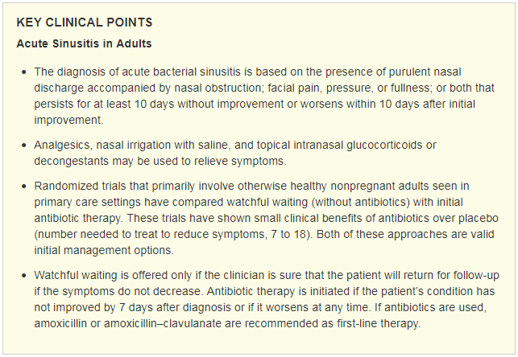
Sinusitis
N Engl J Med 2016; 375:962-970

Slide 10
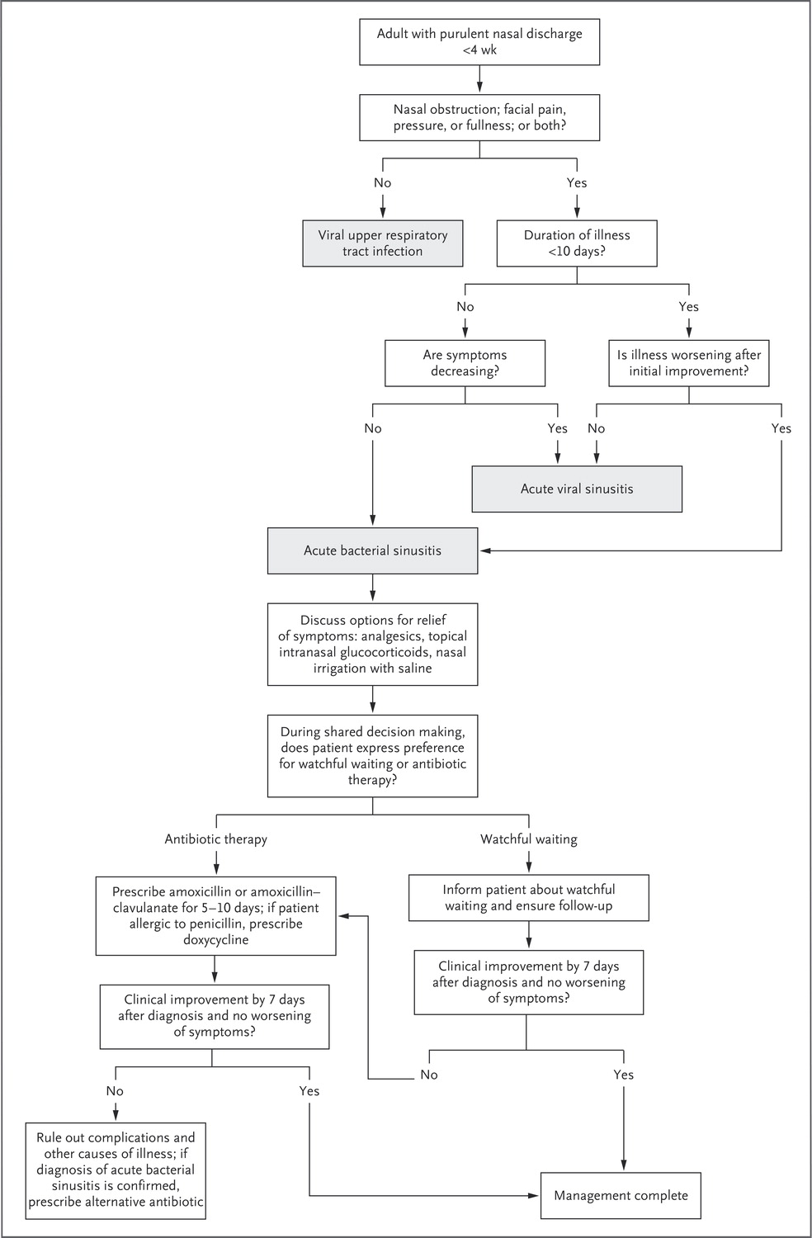
Sinusitis
Pathogens:
Acute viral sinusitis: (any upper respiratory tract viruses)
Acute bacterial sinusitis: Streptococcus pneumoniae, Haemophilus influenzae, Moraxella catarrhalis
N Engl J Med 2016; 375:962-970

Slide 11
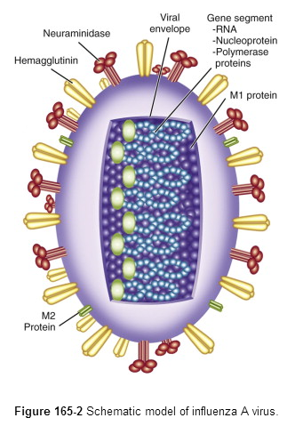
Influenza
Influenza A, B
Described via surface antigens
H (hemagglutinin)
Binds sialic acid/promotes viral entry to host cell
N (neuraminidase)
Promotes progeny virion release
Helical
Nucleocapsid
Negative-stranded
Lipid bilayer
Notes:
Influenza hemagglutinin is a surface glycoprotein that binds to sialic acid residues on respiratory epithelial cell surface glycoproteins. This interaction is necessary for the initiation of infection. After viral replication, progeny virions are also bound to the host cell. Neuraminidase cleaves these links and liberates the new virions; it also counteracts hemagglutinin-mediated self-aggregation entrapment in respiratory secretions
Influenza type C infections generally cause a mild respiratory illness and are not thought to cause epidemics. Influenza D viruses primarily affect cattle and are not known to infect or cause illness in people.

Slide 12
Epidemiology
Influenza epidemics are associated with excess morbidity and mortality
Usually in the form of increased rate of pneumonia and influenza-associated hospitalizations and death
Estimate: 4.1 - 4.5 million excess illnesses in older individuals (common bacterial superinfections with S. aureus, S. pneumoniae, H. influenza)
Excess mortality can be as high as > 50,000 death/year**
Tecumseh Community Health Study
**JAMA 2003. Mortality assoc w Influenza and RSV in US

Slide 13
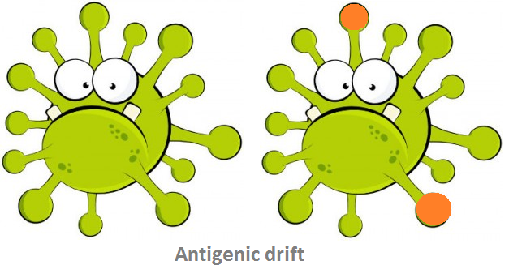
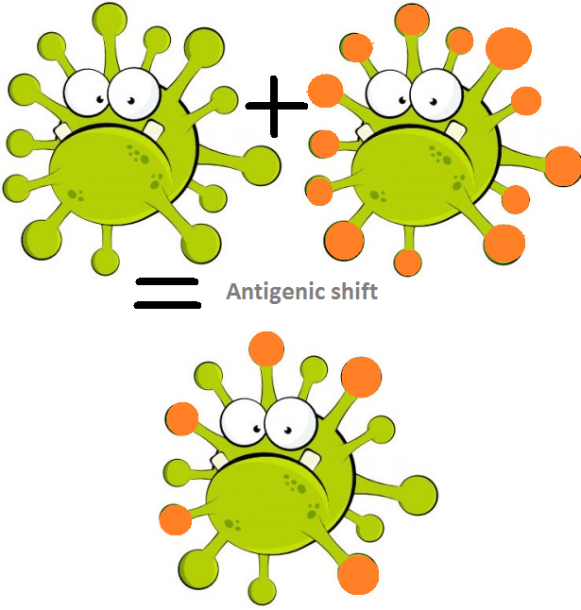
Antigenic Drift/Shift
Antigenic Drift:
Minor antigenic changes based on random mutations of hemagglutinin or neuraminidase genes
Cause epidemics
Antigenic Shift:
Reassortment of viral genome segments
These viruses are “new” viruses to which the population has no immunity = pandemics, more deadly

Slide 14
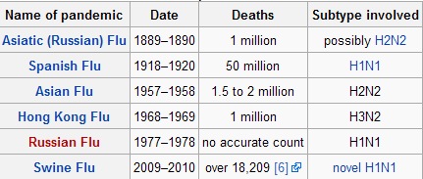
Antigenic shift/Genetic drift
Pandemic influenza
Severe outbreaks of flu that rapidly progress to involve all part of the world
Associated with emergence of new virus
Characterized by:
Higher attack rates, different age distribution, occurs outside usual window of seasonality, multiple waves

Slide 15
Pathogenesis
Virus is deposited on the respiratory tract epithelium-attaches to and penetrate columnar epithelial cells
What normally prevents attachment?
Specific secretory antibody (immunoglobulin A [IgA])
Nonspecific mucoproteins
Mechanical action of mucociliary apparatus
After adsorption, virus replication begins and leads to cell death through necrosis/apoptosis
Virus release initiates infection of adjacent cells
Time to onset of clinical illness (incubation) ~ 1-4 days
Illness duration (if uncomplicated) 2-5 days
Viral shedding ~1 day before symptoms for ~6 days

Slide 16
Transmission
Transmission is mostly large droplets (isolation is “droplet” which = wearing surgical mask)
Transmission requires close contact with an infected person, as large particles do not remain suspended in the air long and can travel only ~6 feet
Possible to transmit via small respiratory droplets which can be suspended longer in air or from fomites containing respiratory secretions
Notes:
Longer periods of shedding can occur in children, older adults, patients with chronic illnesses and immunocompromised hosts

Slide 17
Clinical Symptoms
Fever, chills, headaches, myalgias, malaise, anorexia
Systemic symptoms usually persist for 3 days (the typical duration of fever)
Respiratory symptoms, particularly dry cough, severe pharyngeal pain, and nasal congestion and discharge are also usually present at the onset of illness but may be overshadowed by the aforementioned systemic symptoms

Slide 18
Complications of Influenza
Pulmonary
Primary influenza viral pneumonia
Pneumonia secondary to bacterial infection
Streptococcus pneumoniae
Staphylococcus aureus
Streptococcus pyogenes
Haemophilus influenzae.
Croup
More severe than with parainfluenza
COPD exacerbation

Slide 19
Non-pulmonary Complications of Influenza
Myositis
Mostly children, but also in adults
May interfere with walking
Cardiac
Toxic shock syndrome – likely secondary to change in colonization and replication of staph
Guillain-Barre – only with influenza A
Transverse myelitis
Encephalitis
Reye Syndrome (with use of aspirin in children)

Slide 20
Prevention
Annual vaccination (> 6 mo of age):
Trivalent (2 most prevalent As from year prior + a B)
Quadrivalent (2 As, 2 Bs)
High dose (60 mcg of hemagglutinin per strain vs 15 mcg per strain in standard-dose)
>65 years of age
HIV

Slide 21
Diagnostics
Test Type | Time frame | Comments
RT-PCR (conventional gel-based PCR, real-time RT-PCR, and multiplex PCR) | 1 - 24 hours | High sensitivity and very high specificity (>95 and >99% respectively); highly recommended; can differentiate between influenza types (A or B) and subtypes
Rapid antigen detection (EIA) | 10 - 20 minutes | Sensitivity around 62%, specificity around 98%; high false negative rate; Some tests can detect and distinguish between influenza A and B
Shell viral culture | 48 - 72 hours | Moderately high sensitivity and highest specificity; can confirm screening test results/be helpful in public health surveillance; not useful for timely clinical management
Serologic tests (hemagglutinin inhibition, ELISA, complement-fixation, and neutralization)§ | variable | Available only in reference laboratories; not useful for timely clinical management; recommended only for retrospective diagnosis, surveillance, or research

Slide 22
Early Antiviral Treatment
Can shorten duration of fever and illness symptoms
May reduce risk of complications from influenza (e.g., otitis media in young children, pneumonia, and respiratory failure)
Reduce death in hospitalized patients
Shorten duration of hospitalization in children
Clinical benefit is greatest when antiviral treatment is administered early (within 48 hours of symptom onset)
Some studies have shown benefit in hospitalized pt when therapy started day 4-5 and in pregnant women 3-4 days
Antiviral treatment is recommended as early as possible for any patient with confirmed or suspected influenza who:
Is hospitalized
Has severe, complicated, or progressive illness
Is at high risk for influenza complications

Slide 23
Anti-Influenza Chemotherapy
Inhibitors of Uncoating (block M2)
Rimantadine, amantadine
Developed for influenza A, due to resistance use is no longer recommended
Neuraminidase inhibitors
Oseltamivir
Zanamavir
Peramivir

Slide 24
Anti-Influenza Chemotherapy: Viral neuraminidase inhibitors
Oseltamivir (Tamiflu™)
Pro-drug; activated in gut and liver to inhibit the functioning of the influenza virus neuraminidase
Administered PO; treats influenza A and B
Well tolerated, some nausea and vomiting
Zanamivir (Relenza™)
Inhaled drug - inhibits the functioning of the influenza virus neuraminidase
Treats Influenza A and B
Bronchospasm in asthmatics, nausea and diarrhea
Peramivir (Rapivab™)
Administered IV - inhibits the functioning of the influenza virus neuraminidase
Treats Influenza A and B
Can cause diarrhea

Slide 25
Baloxavir marboxil
Baloxavir marboxil (Xofluza™)
(Novel) polymerase acidic endonuclease inhibitor indicated for the treatment of acute uncomplicated influenza in patients 12 years of age and older who have been symptomatic for no more than 48 hours
1 po dose
Common side effects: diarrhea (3%), bronchitis (2%), nausea (1%)

Slide 26
Influenza Prophylaxis (ppx)
Prophylaxis is NOT a substitute for vaccination
Consider with: close contact with person who has confirmed/probable/suspected influenza if high risk for complication
If < 48 hours since last contact
If contact within 24 hours of infectious period (fever subsiding)
Close contact = individual who has cared for / lived with person with flu or high likelihood of contact with respiratory droplets and/or body fluids (talked face to face with a person with suspected or confirmed influenza infection/intubated them, etc.)

Slide 27
SARS-CoV
Severe acute respiratory syndrome
Novel betacoronavirus identified 2003
Guangdong Province of China, then Hong Kong, Vietnam, Singapore, and Canada
Total of 8096 cases, 774 deaths, case-fatality rate of 9.6%

Slide 28
Case Definition
Fever AND
1 or more respiratory symptom (cough, shortness of breath) AND
Radiographic evidence of lung infiltrates consistent with ARDS AND
+Diagnostic test direct link to MERS-CoV case
OR testing not avail OR inclusive AND worked in a lab with live SARS coronavirus/resides in Middle East where virus is circulating
PCR, neg to + Ab titer by ELISA or IFA and neutralization assay

Slide 29
MERS-CoV
Middle East respiratory syndrome coronavirus
Novel betacoronavirus identified 2012
Saudi Arabia, Quatar, Jordan, N. Africa, Europe
2494 cases, 858 deaths, case-fatality rate 34/4%

Slide 30
Case Definition
Fever AND
1 or more respiratory symptom (cough, shortness of breath) AND
Radiographic evidence of lung infiltrates consistent with ARDS AND
No alternative diagnosis fully explaining the illness WITH
+Diagnostic test or worked in a lab with live SARS coronavirus
PCR, viral culture, neg to + Ab titer (or 4x rise) by ELISA or IFA

Slide 31
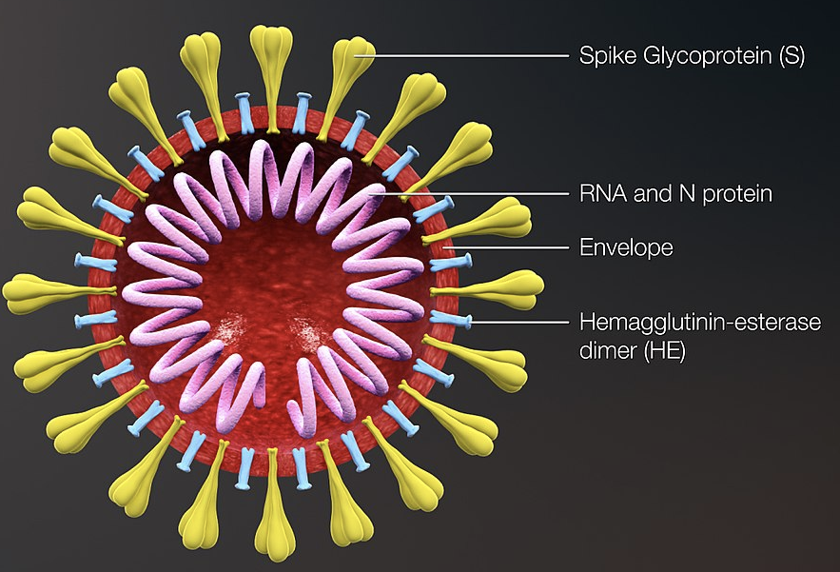
SARS-CoV-2
Novel betacoronavirus identified December 2019
Hubei Province of China, Japan, S. Korea -> worldwide
Lipid bilayer
S (Spike Glycoprotein)
Binds to cell ACE-2 and allows for viral entry

Slide 32
Pathogenesis/Transmission
The host receptor for SARS-CoV-2 cell entry is the same as for SARS-CoV: the angiotensin-converting enzyme 2 receptor-binding domain of its spike protein
Person to person spread via respiratory particles (mostly w/in 6 feet); can also be transmitted via direct contact with droplets (hands to mucous membranes) or airborne
Time to onset of clinical illness (incubation) ~ 2-14 days
Viral shedding ~2 days before symptoms for ~7-10 days
Duration of illness: variable

Slide 33
Approach to a respiratory viral case
Clinical example:

Slide 34
Case 1
Chief complaint: cough
57-year-old woman presents with cough x 1 week; occasional clear sputum
Noted also x 1 week SOB and dyspnea with exertion
The last few days malaise and temperature up to 101.0°F

Slide 35
Review of Systems
Additional pertinent positives: night sweats, chills, fatigue, rhinorrhea, anorexia
Pertinent negatives: Headache, chest pain, palpitations, nausea, vomiting, abdominal pain, change in stools, joint pain or joint swelling, skin rash or lesions

Slide 36
History
Past Medical History:
Acute myelogenous leukemia
Status-post matched sibling donor stem-cell transplant 6 months ago
Treatment was complicated by graft versus host disease treated with immunosuppressant therapy
Hypothyroidism
Surgical History: remote ankle fracture (hardware required for fixation)

Slide 37
History, cont.
Social history/exposure history:
Former smoker, no ETOH or recreational drug use
Married and lives in Kansas
Pet (outdoor) cat, no farm animal/bird exposure
No recent travel, went to Canada last spring
Spends time indoors mostly – no recent camping, hiking, fishing, gardening
No ill contacts but volunteered in her church nursery 2 last Sunday

Slide 38
Physical Examination
Temp: 38.3 ºC P: 90 R: 20 BP: 102/72 O2 sat: 93% RA
Gen: alert & oriented, appears fatigued
HEENT: pupils symmetrical/responsive, conjunctiva normal, no oral lesions or thrush
Neck: supple, no lymphadenopathy
Lungs: slightly diminished basilar breath sounds, no crackles
CV: Regular rhythm, slightly tachycardic, no murmur or gallop
Abdomen: soft, no tenderness, normal bowel sounds, no organomegaly
Extremities: no edema, normal distal pulses
Skin: no lesions; diffuse dry skin

Slide 39
Questions
What types of infections could cause this patient’s cough? (create a differential diagnosis)
Virus? Bacteria? Fungus? Parasite?
What if anything about this differential diagnosis changes because she is immunocompromised?
What testing would you order to try to narrow your differential?

Slide 40
Questions
What types of infections could cause this patient’s cough? (create a differential diagnosis)
Any respiratory virus, atypical respiratory bacteria, possibly histoplasmosis, cryptococcus, mold or Pneumocystis jiroveci
What if anything about this differential diagnosis changes because she is immunocompromised?
Latter of above differential would be much less common in an immunocompetent individual
What testing would you order to try to narrow your differential?
CBC with differential, CMP, CXR, possibly rapid influenza or RSV testing, respiratory viral panel, possibly β-d-glucan test

Slide 41
Objective data
Laboratory
A CBC with differential shows a Hgb of 9.5 grams (normal 12-15 grams) and WBC of 3.1 (normal 4.5 - 11.0 K/UL)
A complete metabolic profile is normal
Notes:
Does this help with your differential diagnosis?

Slide 42
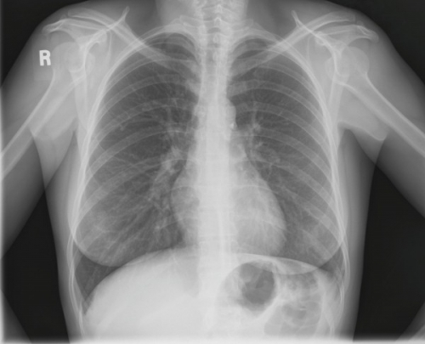
Normal chest radiograph
Notes:
How do you read a chest xray? ABCDE; airway, bones, cardiac silhouette, diaphragm, everything else (tubes, lines, lung parenchyma)

Slide 43
Respiratory viruses - Imaging
If upper respiratory viral infection progress to LOWER respiratory viral infection: can cause a wide range of imaging findings
Interstitial infiltrates
Ground glass opacities
Airspace consolidation
Small peribronchial nodules

Slide 44
Diagnosis
Three general approaches to suspected viral upper respiratory tract infection:
Viral culture
Detection of viral antigen or nucleic acid
Serologic analysis
“Gold standard” remains the isolation of virus in tissue culture
Difficult and not clinically useful to make treatment
Serology: useful in occasional clinical scenarios
RT- PCR can be rapid (1-8 hrs); > 95% sensitive, ~99% specific

Slide 45
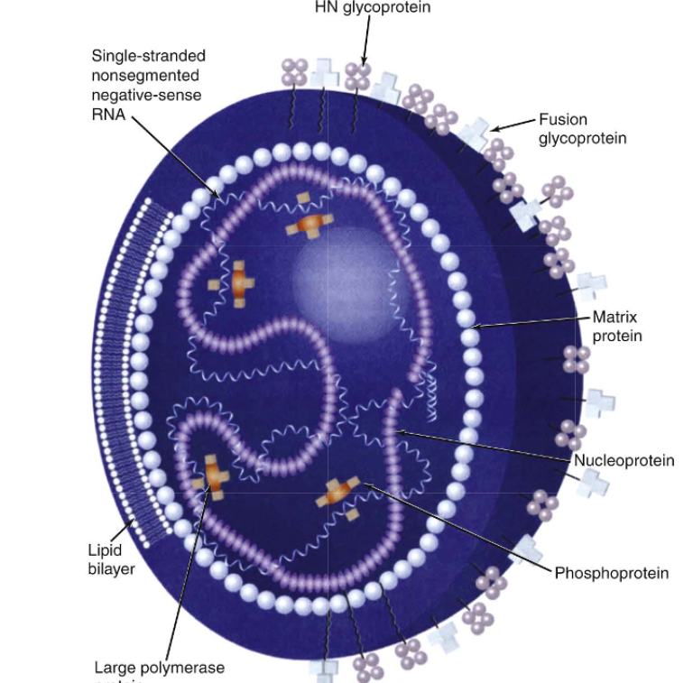
Parainfluenza
This patient’s diagnosis was confirmed on RVP
Parainfluenza virus infection
Four major serotypes (1-4)
Reinfection is common
Notes:
Paramyxovirdae family, also includes measles, mumps, RSV Human metapeumo and 2 other viruses

Slide 46
Pathogenesis
Preferentially infects ciliated epithelial cells
Limited direct pathological effect on respiratory cells (illness driven by immune response as is the case with most respiratory viral infections)
Immune Response
Humoral
Neutralizing antibody to surface proteins
Mucosal IgA can help prevent Cellular-Cytotoxic T cells
Lack is associated with progressive disease as seen in HSC
Most typically cause illness in the large airways of the lower respiratory tract:
Croup, bronchiolitis, but can also cause pneumonia
Notes:
The reasons for this particular localization are not known.
As with influenza viruses, a surface protein of parainfluenza viruses, the fusion or F protein, is cleaved by a serine protease, a process necessary for replication of the virus

Slide 47
Parainfluenza
Can cause severe disease in both adult and pediatric hematopoietic stem cell transplants (HSCT) and in solid organ transplant recipients
Mortality rate of up to 37% with pneumonia

Slide 48
Therapy
Croup – supportive care
Immunocompromised/transplant
Reduce immunosuppression- mainly steroids
Investigational treatments being studied
*Trans Inf Diseas 2013 and Trans Inf Dis 2014

Slide 49
Summary
URI is a common, undifferentiated (usually viral) syndrome of the upper respiratory tract
“Atypical” bacteria in URI include Mycoplasma pneumoniae which can also cause pneumonia and have extra-pulmonary manifestations
Common respiratory viruses include: rhinovirus, enterovirus, coronaviruses, RSV, parainfluenza virus, human metapneumovirus, influenza viruses and adenovirus
Group A streptococcus pharyngitis should be evaluated for with > 2 Modified Centor criteria
Bacterial sinusitis is typically accompanied with headache, purulent nasal discharge and symptoms > 10 days; ok to watch if pt can follow-up within 1 week
Influenza can be associated with pulmonary and extrapulmonary complications; vaccination is encouraged for prevention

Slide 50
Individual Readiness Assurance Test
List 3 common upper respiratory viral pathogens
A 30-year-old female presents with sore throat, tonsillar exudate, temperature 38.3 C and no cough/lymphadenopathy. Should you perform rapid strep/throat culture?
What pathogens cause acute bacterial sinusitis in adults?
What surface antigens describe an influenza virus strain?
If the prominent influenza virus of a flu season was created via reassortment of viral genome segments, then then strain is demonstrating what property?
Influenza virus treatment is most effective if started within how long from time of symptom onset?
Rhinovirus, enterovirus, coronavirus, parainfluenza virus, human metapneumovirus, RSV
Yes, 3 points on Modified Centor score
Streptococcus pneumoniae, Haemophilus influenzae, Moraxella catarrhalis
Neuraminidase, hemagglutinin
Antigenic shift -> leads to pandemics
Within 48 hours of symptom onset

