Slide 1
Community-Acquired Pneumonia
Infectious Diseases Elective

Slide 2
Overview
Prevention
Symptoms/diagnosis
Cases
Treatment

Slide 3
CAP - Prevention
Smoking cessation
Influenza vaccination
Prevents/lessens illness in adults
Secondarily reduces likelihood of secondary bacterial pneumonia
Pneumococcal vaccination:
Adults >65, PCV15 followed by PPSV23 1 year later OR just PCV20
AND individuals at risk for invasive pneumococcal disease: long term care facility residents, those with CAD, heart failure, COPD, alcoholism, diabetes, CSF leak, cirrhosis, asplenia (including functional), immunocompromised patients
Individuals who have already received PPSV23: PCV15 or PCV20 1 year later
Individuals who have already received PCV13: give PPSV23 2 months later
COVID-19 vaccination
https://www.cdc.gov/vaccines/vpd/pneumo/hcp/who-when-to-vaccinate.htmls

Slide 4
Microbiology
Community-acquired pneumonia
Organism | Clues | Treatment
Atypical pathogens
Legionella | hotel, cruise ship stay; grocery store mister, hot tub | azithro, respiratory fluoroquinolone
Chlamydia pneumoniae/psittaci | C. psittaci = birds | azithro, doxy, respiratory fluoroquinolone
Mycoplasma pneumoniae | in school, military | azithro, doxy, respiratory fluoroquinolone
Typical pathogens
S. pneumoniae | most common pathogen | Ceftriaxone
H. influenzae | chronic respiratory disease | Ceftriaxone
S. aureus | recent influenza infection | Vancomycin, linezolid, Ceftaroline
Pseudomonas aeruginosa | COPD, bronchiectasis, CF | Pip/tazo, cefepime, aztreonam, meropenem/imipenem, aminoglycosides (need susceptibilities)
Gram negatives/anaerobes | Aspiration, alcoholism, post-obstructive, diabetic | Broad-spectrum antibiotic with both gram-negative and anaerobic coverage

Slide 5
Symptoms & Diagnosis
Symptoms: Fever, cough, sputum production and shortness of breath (possibly with chest pain)
Absence of fever can be seen in older adults or in the immunocompromised
Diagnosis: infiltrate on a chest radiograph is required for diagnosis of CAP
CAP = acquired outside of a healthcare setting
Workup: blood cultures, sputum culture (for patients needing hospitalization) and those with underlying lung disease, alcohol abuse, asplenia, chronic liver disease, leukopenia or those who fail outpatient empiric therapy
Consider urine legionella and S. pneumo ag testing in admitted patients
Urine legionella only detects serotype 1
Hospitalization? Tools: 02 Sat < 92%, Pneumonia severity index (PSI) score > or = Class III
CURB 65 (1 point for each of confusion, BUN>20, RR> 30, BP< 90 systolic or <60 diastolic and age >65): >2 consider admission

Slide 6
Approach to a patient with possible CAP

Slide 7
Case 1
76-year-old male with DM (A1c 6.8%), s/p left BKA (due to PVD), CAD s/p CABG in 1994, Afib s/p ablation and PPM, aortic stenosis (relatively asymptomatic)
4 days prior to presentation: having chills, fever to 102°F and worsening fatigue; symptoms progressed and patient presented for evaluation to ED
ROS:
Pertinent positives: anorexia, fatigue
Negative: HA, sinus congestion, rhinorrhea, sore throat, cough, CP, n/v/abd pain, diarrhea, muscle/joint pains, rash

Slide 8
History
Social/exposure history:
Marital status/area of residence: married, lives w/wife
Job/occupation: retired; works in woodworking in free time
Travel history: none recent, no travel to desert SW US or abroad
Animal, bird exposures: outdoor cats on property
Environmental/outdoor/food exposures: water leaking in his workroom, sawdust, moldy wood
Recent ill contacts: no
TB exposure: none
Drugs of abuse: no
Tobacco: former smoker
ETOH: denies

Slide 9
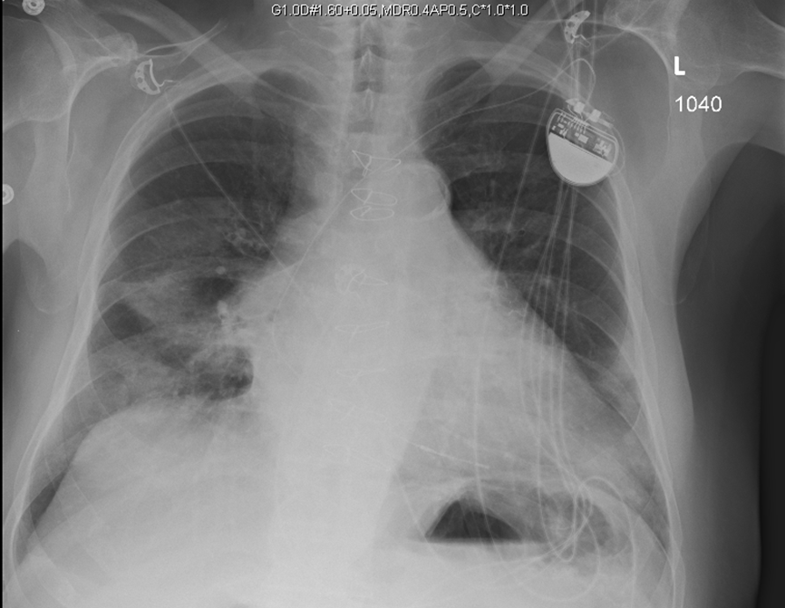
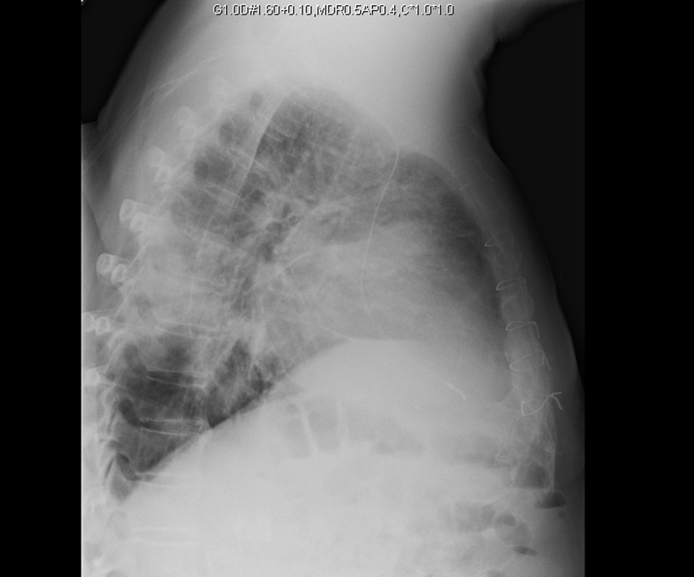

Slide 10
Initial Impression
What is your initial assessment?
What is on your differential for pathogens involved?
What other diagnostics would you consider?
What antimicrobial therapy would you start?

Slide 11
History
Started on empiric antibiotics with ceftriaxone and azithromycin
COVID-19 PCR negative
No improvement in CXR next am; therapy changed to Piperacillin/tazobactam
CT chest with bilateral pleural effusions – concern for empyema and transferred to tertiary care center
Day 5 fever improved
WBC 12.2 w/84% neut. Hgb normal. Na 132, K 4.1, Creat 1.3, LFTs were normal, though bilirubin 2.3. UA normal

Slide 12
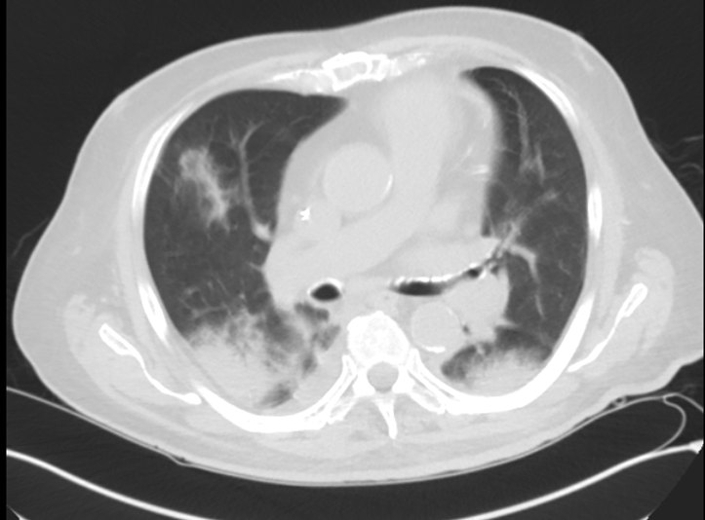
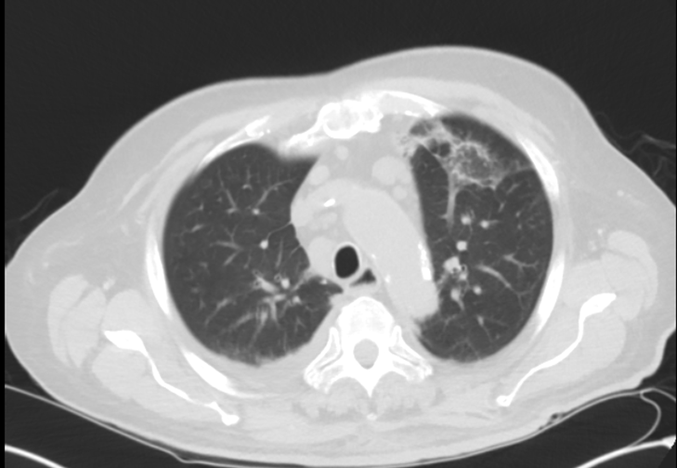

Slide 13
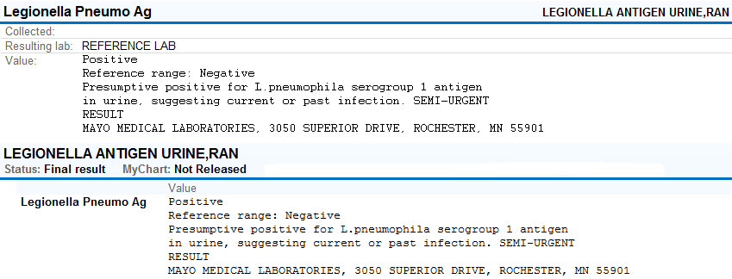
Blood cultures: negative
Sputum culture: “normal respiratory flora”

Slide 14
Brief review of Legionella Infection
1-10% of CAP cases; many serogroups – most disease = group 1
Legionnaires’ disease can be associated with waterborne outbreaks (cooling towers/water systems)
Peaks late summer-early fall
High fever (>39ºC) very common; GI/neuro symptoms common, incidence of cough can be as low as 40%, hyponatremia more than w/other PNAs
Diagnosis: gold standard = culture (buffered charcoal yeast extract agar)
More commonly used: urinary Ag (sensitivity >80%, very specific) but only picks up serotype 1 and PCR (high sensitivity/specificity)
Lancet Infect Dis. 2014 Oct;14(10):1011-1021. doi: 10.1016/S1473-3099(14)70713-3. Epub 2014 Jun 23.
Cristovam E, Almeida D, Caldeira D, Ferreira JJ, Marques T. Accuracy of diagnostic tests for Legionnaires' disease: a systematic review. J Med Microbiol. 2017 Apr;66(4):485-489. doi: 10.1099/jmm.0.000454. PMID: 28463665.

Slide 15
Treatment of CAP
On presentation, pathogen will be unknown
If outpatient micro testing not routinely performed (can use amox vs. amox/clav with or w/o atypical coverage )
Inpatients: antimicrobial coverage required for atypical + typical (common) organisms
β-lactam + azithro vs. doxy vs. respiratory fluoroquinolone (levaquin or moxifloxacin)
In patients with CAP requiring ICU admission
β-lactam + azithro vs. respiratory fluoroquinolone
β-lactam = cefotaxime, ceftriaxone or amp-sulbactam
If risk for PSAE or if GNR on sputum GS: instead of above β-lactam use cefepime, pip/tazo or meropenem + levaquin OR azithro + aminoglycoside
If staph on GS consider adding vancomycin or linezolid

Slide 16
Individual Readiness Assurance Test
What are 3 common presenting symptoms of CAP?
What tool can help determine need for admission for a CAP patient?
How would you categorize a pneumonia in a patient who lives at home and attends dialysis 3x/week?
Which vaccinations can help prevent CAP?
List 3 “atypical” pathogens in CAP?
A legionella urine antigen detects which serotype?
What antibiotic would you recommend for S. pneumoniae pneumonia in a patient being admitted with hypoxia and fever?
Fever, cough, shortness of breath
CURB 65
CAP
Influenza, Pneumococcal, COVID-19
Legionella, Mycoplasma pneumoniae, Chlamydia pneumoniae
1
Ceftriaxone
SLIDE UDPATES: 6/2022
Notes:
Changed #3

