Slide 1
Infections in the Immunocompromised
Infectious Diseases Elective
Jayhawkid.com
Updated 6/2/22

Slide 2
Overview
Review: types of immunity
Application: clinical cases
Type of immune deficiency, pathogen risk, differential diagnosis, treatment
Timing and type of infection in solid organ transplant
Timing and type of infection in stem-cell transplant

Slide 3
Before immunocompromised: immunity
How do we protect ourselves?
2 fundamentally different types of responses to invading pathogens
1. Innate immunity
2. Adaptive (acquired) immunity

Slide 4
Innate vs. Adaptive
Innate Immunity
“Hardwired” responses - born with this
Defense mechanisms responding immediately or within hours of an antigen’s appearance
Designed to recognize a few highly conserved structures present in many organisms (e.g. DS DNA, lipopolysaccharide, etc.)
Adaptive immunity
Immunity one develops throughout life
Slower, but able to respond to many more antigens than innate
Proliferation of B and T lymphocytes in response to antigen recognition

Slide 5
Innate vs. Adaptive Components
Innate Immunity
Phagocytic cells
Macrophages / monocytes
Cells that release inflammatory mediators
basophils, eosinophils, neutrophils
NK cells (innate & adaptive)
Molecular components (complement, acute phase proteins, cytokines)
Adaptive immunity
Antigen presenting cells (APCs) - macrophages / dendritic cells
B-lymphocytes
Production of antibodies
T-lymphocytes

Slide 6
Adaptive Immunity
Production of antibody in response to an antigen & mediated by B-cells
Involves the production of cytotoxic T-cells, activated macrophages, activated NK cells & cytokines in response to an antigen / mediated by T-cells
Humoral
Cell-
Mediated

Slide 7
Immunodeficiency = risk for infection
T cell dysfunction (ex: HIV, Hyper IGE)
B cell dysfunction (ex: IgA def, X-linked agammaglobulinemia)
Fungal infections
Pneumocystis
Candida
Cryptococcus, etc.
Viral infections
CMV
EBV
HSV
Humoral immunity -> poor Ab production
Bacterial infections
Sinopulmonary infections
Particularly encapsulated – opsonization lacking
S. pneumoniae, H. influenza, Neisseria, etc.
Chronic Diarrhea
Salmonella / Campylobacter
Certain viruses – e.g. enterovirus, rotavirus
(Fungal less likely)
CVID patients have B & T cell abnormalities with low immunoglobulins levels; treatment = IVIG

Slide 9
Case 1
27-year-old man with HIV
3-4 weeks shortness of breath
Onset initially going upstairs but more recently has been having sob with minimal activity
1-2 weeks of non-productive cough
Intermittent fevers to 39⁰C
Moderate-severe headache, worsening

Slide 10
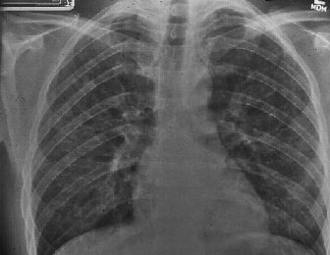
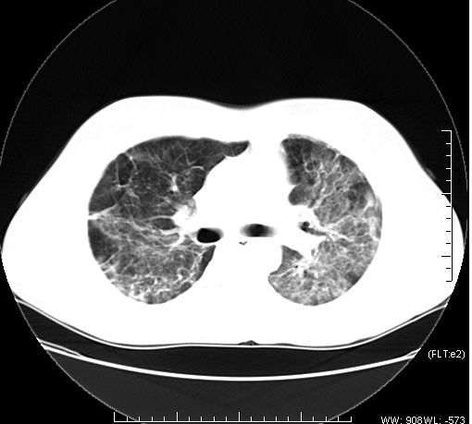
CD4 = 50 cells/ml What is the host’s immune problem? What pathogens are common with this immune defect? What is the most likely diagnosis?

Slide 11
Case 1-Questions to consider
Blood & sputum culture, viruses (flu, covid-19, RSV), LDH, Fungitell, sputum silver stain, consider BAL for PJP PCR
Trimethoprim/ sulfamethoxazole + CAP abx
Not today but within 2 weeks; consider genotype first
It would lower it, but would not remove PJP from differential
What diagnostic testing would you order?
Would you start empiric treatment? If so, what?
Should you start HIV therapy if he was not already on it?
If the patient was on bactrim prophylaxis would that influence your suspicion?

Slide 12
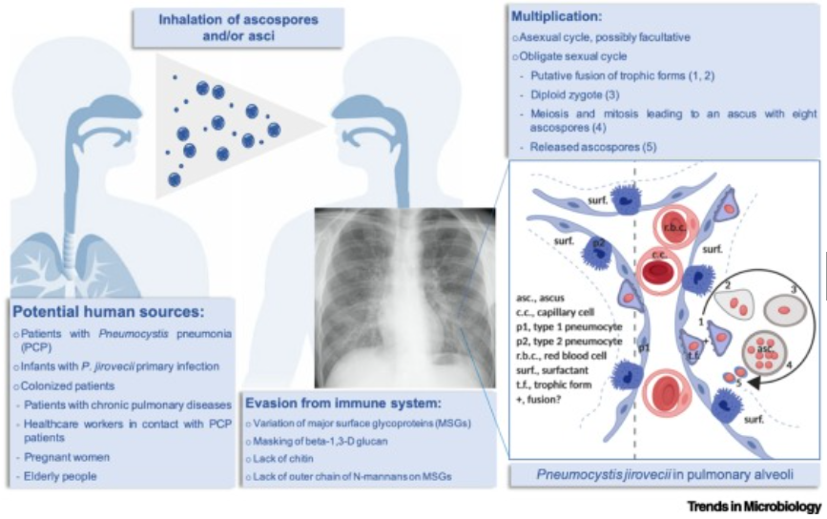
Pneumocystis jiroveci (PCP) pneumonia
The classic presenting triad:
fever (79-100%)
exertional dyspnea (95%) desaturation with ambulation
nonproductive cough (95%)
Other common presenting features (nonspecific)
fatigue
chills
headache
chest pain
weight loss
hypoxia
Symptoms present over weeks to months

Slide 13
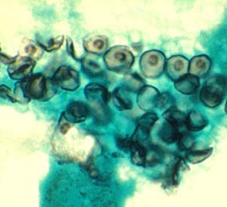
Diagnosis of PCP
Gomori Methenamine Silver Stain from induced sputum or BAL
PCR
From induced sputum and BAL
sensitivity 81%-100%
specificity 86%-100%
PCR from oropharyngeal washings and serum
not shown to be useful
Notes:
Because certain processes produce similar clinical manifestations, a specific diagnosis of PCP should be sought rather than relying on a presumptive diagnosis, especially in patients with moderate-to-severe disease. Treatment can be initiated before making a definitive diagnosis because organisms persist in clinical specimens for days or weeks after effective therapy is initiated

Slide 14
Additional Diagnostic Tests for PCP
LDH
Sensitivity 82%-100%; poor specificity
Useful for estimating prognosis and following response
Correlation between degree of serum elevation and survival and change in level and clinical response
Oxygenation at rest and exercise
PJP highly unlikely if there is no drop in O2 saturation with exercise
1,3 ß-D-glucan (fungitell)
Sensitivity 92% Specificity 65%
PPV 85% (95% CI, 79%-90%) and NPV 80% (95% CI, 68%-89%)
Notes:
CID 2011- 408 HIV infected pt enrolled in ACTG trial a study of early versus deferred antiretroviral therapy in conjunction with initial therapy of acute OI. 65% w PCP

Slide 15
Treatment of PCP
DRUG | Dose | Route | Comments
TMP / SMX (Bactrim) | 15-20 mg/kg/d TMP component Divided q 8hr | PO/ IV | Treatment of Choic
Primaquin + Clindamycin | 30 mg PO once daily + 600-900 IV q 8 (600mg po TID if less severe) | PO/IV | Alternate
Pentamidine | 4mg/kg or 600mg | IV | Alternate
Atovaquone | 750 mg BID | PO | Alternate (less severe)
Dapsone/TMP | 100mg + TMP 15mg/kg/day 3 divided doses | PO | Alternative (less severe)
Notes:
Mutations associated with resistance to sulfa drugs have been documented, but their effect on clinical outcome is uncertain.73-76 Patients who have PCP despite TMP-SMX prophylaxis usually can be treated effectively with standard doses of TMP-SMX

Slide 16
Treatment of PCP
Treat for 21 days
Continue initial regimen for 4-8 days before determining treatment failure as sometimes patients will deteriorate before improving
Alternative second line agents:
Pentamidine side effects: renal, cardiac (torsades or ventricular arrhythmias), GI (pancreatitis), hypoglycemia
Primaquine/dapsone: methemoglobinemia and hemolysis (G6PD deficiency)
**HIV treatment should be initiated within 2 weeks
Notes:
In a randomized controlled trial of 282 patients with opportunistic infections (OIs) other than TB, 63% of whom had PCP, a significantly lower incidence of AIDS progression or death (a secondary study endpoint) was seen in subjects randomized to early (median 12 days after initiation of therapy for OI) versus deferred initiation of ART (median 45 days).99 Of note, no patients with PCP and respiratory failure requiring intubation were enrolled in the study.99 Paradoxical immune reconstitution inflammatory syndrome (IRIS) has been reported following PCP.100 Most cases have occurred within weeks of the episode of PCP;

Slide 17
Role of Steroids in PCP
Indicated for Pa 0₂ <70 or A-a grad >35 mm Hg
Also consider with progression of the disease even if they do not meet the above criteria
Prednisone :
40 mg PO bid x 5 days (d 1-5)
40 mg PO QD x 5 days (d 6-10)
20 mg PO daily x 11days (d 11-21)
Caution: Other OIs can initially respond to steroids (i.e. TB, Histo)
As a general rule, if patients receive steroids, the diagnosis should be confirmed with induced sputum/bronchoscopy

Slide 18
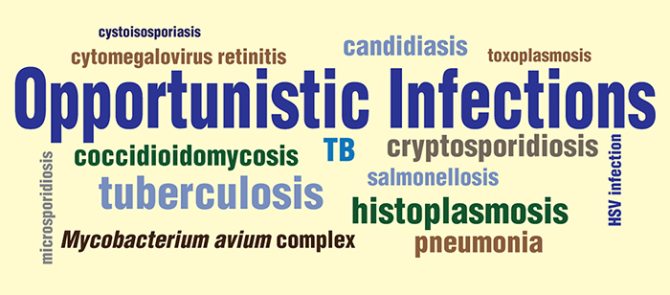
Other Opportunistic Infections in HIV
Other common OIs
Esophageal candidiasis
Cryptococcal meningitis
CNS toxoplasmosis
Disseminated Mycobacterium avium infection and TB
CMV retinitis/esophagitis/colitis
For other OI’s:
https://hivinfo.nih.gov/understanding-hiv/fact-sheets/what-opportunistic-infection

Slide 19
Case 2
CC: skin lesion
HPI: 60-year-old male with
Nodular lesion on forearm for weeks
New this week is ulcerating with surrounding erythema
2 new small nodules proximal to the lesion on the forearm
Cephalexin was started by PCP
2 days later
Still expanding and more painful
Swelling extended to above the elbow
Notes:
19

Slide 20
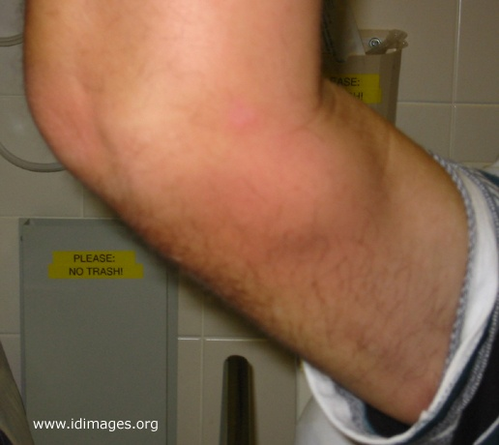
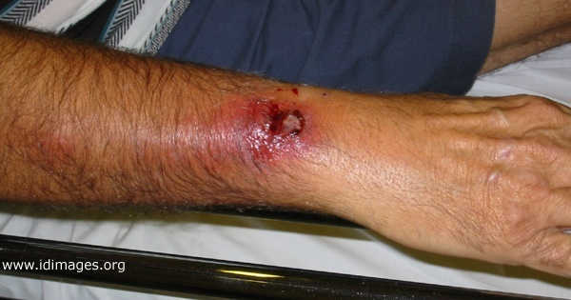
Case History
Notes:
20

Slide 21
What other history do you need?
PMHx: polymyalgia rheumatica; on prednisone 40 mg daily for 3 months; no prior history of frequent infections
Social: Married, lives w/wife – they spend winters in Florida. No other recent travel. No tob/ETOH/drug use. Retired from sales
Exposures:
Gardens frequently; scraped arm on metal in an area of overgrown weeds 1 month ago; no rose bushes in area, occasionally sees rabbits but no direct contact. No fresh/salt water exposures, no HIV risk factors

Slide 22
Differential diagnosis
Infectious disease
Viral:
Fungal:
Bacterial:
Parasitic:
Trauma
Hematologic/onc

Slide 23
Differential diagnosis examples
Infectious disease
Viral:
Monkeypox
Fungal:
Sporothrix schenckii, Coccidiomycoses, Cryptocococcus neoformans, Histoplasmosis, Blastomycosis
Bacterial:
Francisella tularensis (ulceroglandular type) Nocardia brasiliensis, Bartonella henslae
Mycobacterial: Mycobacterium marinum, Mycobacterium chelonea, Mycobacterium ulcerans
Parasitic:
Leishmania braziliensis
Trauma
Tendon rupture
Heme/onc
Thrombus, soft tissue tumor

Slide 24
Which test will be most helpful in confirming the diagnosis?
Urine antigen test
Blood culture
Stain and culture of wound
CT of arm
Serological test

Slide 25
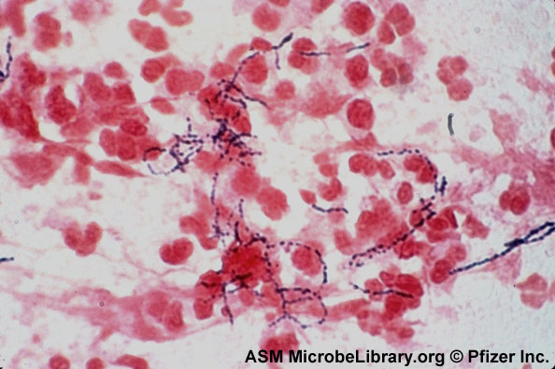
What is your diagnosis?
Notes:
25

Slide 26
Diagnosis of Nocardia
Stain
Branching, beaded, gram-positive filaments
Most are acid-fast in direct smears if a modified stain (Kinyoun or Ziehl-Neelsen)
Often take up silver stains
Culture
Grows relatively slowly (up to 2-4 weeks)
Grows in some blood culture systems
Notes:
26

Slide 27
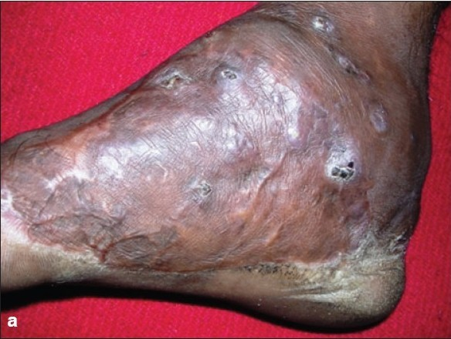
Cutaneous Manifestations of Nocardiosis
Primary cutaneous
Results from direct inoculation
Lymphocutaneous
Extension of untreated primary cutaneous often is initial presentation
Mycetoma
Chronic suppurative granulomatous reaction secondary to Nocardia or other pathogens
Disseminated
Cutaneous involvement a component of disease
http://www.ijdvl.com/viewimage.asp?img=ijdvl_2008_74_6_635_45110_u1.jpg
Notes:
27

Slide 28
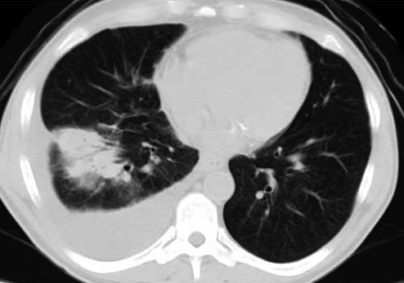
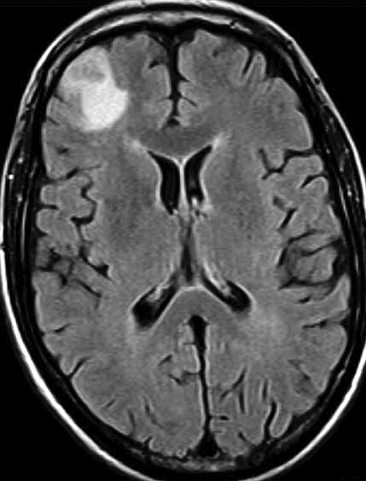
Lung and brain Nocardia lesions

Slide 29
Treatment of Nocardia
Clinical Syndrome | Duration | Therapy
Cellulitis/ Lymphocutaneous syndrome | 2 mo | Oral Trimethoprim/sulfamethoxazole Minocycline Linezolid Parenteral Trimethoprim/sulfamethoxazole Amikacin Imipenem
Pulmonary or systemic
Intact host defenses | 6–12 mo
Deficient host defenses | 12 mo
CNS disease | 12 mo
Osteomyelitis, arthritis, | 4 mo
Laryngitis, sinusitis | 4 mo
Notes:
29

Slide 30
Infections in solid organ transplant recipients

Slide 31
Infections after SOT
Infection risk depends on
Host: seropositivity for microbes pre-transplant (i.e. CMV, HSV, T spot)
Immune suppression: glucocorticoides, cytotoxic agents (mycophenolate, cyclophosphamide, azathioprine), calcineurin inhibitors (cyclosporin, tacrolimus), mTOR inhibitors (sirolimus) or lymphocyte depleting agents such as anti-thymocyte globulins
Post-transplant complications: (i.e. GVHD)
Time: since transplant

Slide 33
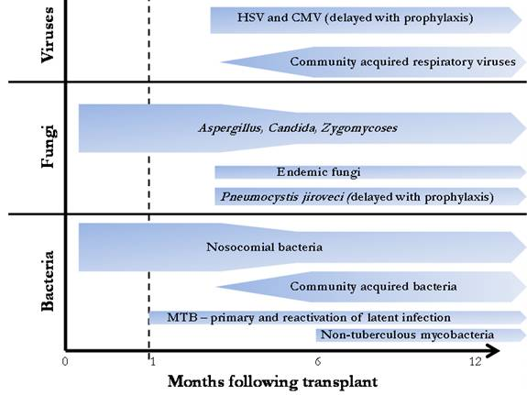
Viral infections post-transplant
CMV – lowest risk is if patient and donor are both seronegative; ranges from nonspecific febrile illness (with leukopenia/thrombocytopenia) to life-threatening organ specific infection (esophagitis, pneumonitis, colitis, hepatitis)
EBV – most significant complication is in post-transplant lymphoproliferative disease (fever and adenopathy)
HHV6 – fever, rash, myelosuppression, hepatitis and can cause encephalitis/meningitis/pneumonitis as well
http://www.antimicrobe.org/t35.asp

Slide 34
Case 3
35-year-old woman; history of glycogen storage disease (GSD) Type III
S/p liver transplantation several years ago
Immunosuppression: tacrolimus/azathioprine
Routine labs: AST/ALT/T. bili - elevated
Underwent liver biopsy = inflammation -> prednisone 20 mg BID added

Slide 35
Course
Liver enzymes improved on prednisone/tacrolimus/ azathioprine/sirolimus
Process started for re-listing for repeat transplantation
Several months later developed CNS symptoms
Lightheadedness
“Leaning right” when walking
Rhythmic shaking of arm

Slide 36
Past Medical History
Glycogen storage disorder type IIIa (glycogen debrancher deficiency) s/p OLT
Chronic hypersplenism
Pancytopenia

Slide 37
Social/exposure history
From southeastern US; works in finance
1 cat. No other animal exposures
No travel to desert US or abroad
No TB exposures
Vaccinations up to date
No tobacco, ETOH or recreational drug use. Does not eat undercooked meat or raw shellfish, drinks bottled water
CMV IgG+
Varicella IgG+
Rubella immune
HBV immune

Slide 38
Exam and Lab
Gen/MS: Awake, alert and oriented. Slow to answer some questions. Normal Cognition, Speech: Fluent
CN: PERRLA, EOMI, visual fields full, sensation and strength in face normal, symmetric palatal elevation, tongue is midline, Motor: Symmetric 5/5 strength. Mild RUE pronator drift
DTRs: BR 3/3, Biceps 3/3, triceps 2+/2+, patellar 3/3, ankle jerk 2+/2+, toes downgoing
Sensation: Light touch/proprioception: normal
Coordination: RUE dysmetria with “finger-to-nose”, normal “heel-to-shin”
Urinalysis: Neg
WBC: 9.3
Hgb: 12.7g
Plt: 58,000
N: 65% B: 13% L: 6%
INR: 1.6
Na: 137
K: 3.5
Cl: 105
CO₂: 24
BUN: 17
Cr: .76
T. prot: 4.9
Alb: 1.9
T. bili: 37.7
Alk phos: 138
AST: 486
ALT: 529

Slide 39
CT Head w/o contrast

Slide 40
MRI T2 FLAIR images

Slide 41
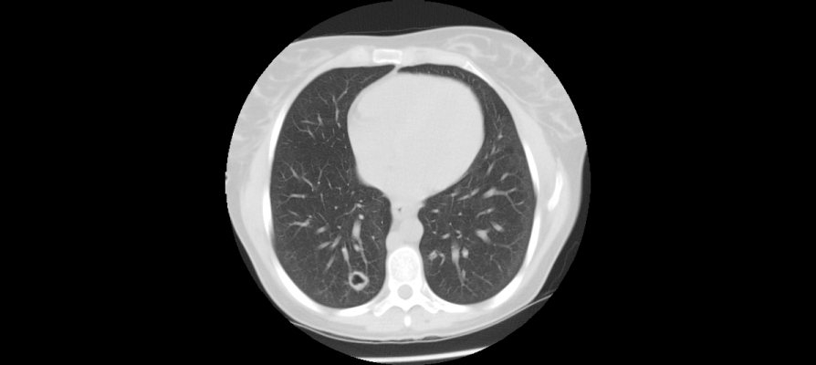
Findings prompted CT chest

Slide 42
What is the most likely pathogen?
Bacterial infection (e.g. Nocardia)
Fungal / mold infection
Neoplasm (e.g. lymphoma)
Vascular infarct
Parasitic infection (e.g. Toxoplasma)

Slide 43
Additional studies
Laboratory:
1,3 Beta-D glucan level > 500
Toxoplasmosis IgG neg
Cryptococcal ag (CSF) neg
Histo urine ag neg; CSF Histo ab neg
Serum galactomannan 0.634 (nml < 0.5)
CSF galactomannan 2.53
CSF Aspergillus PCR equivocal
CSF cytology negative for malignant cells
Treatment started:
IV voriconazole
IV micafungin

Slide 44
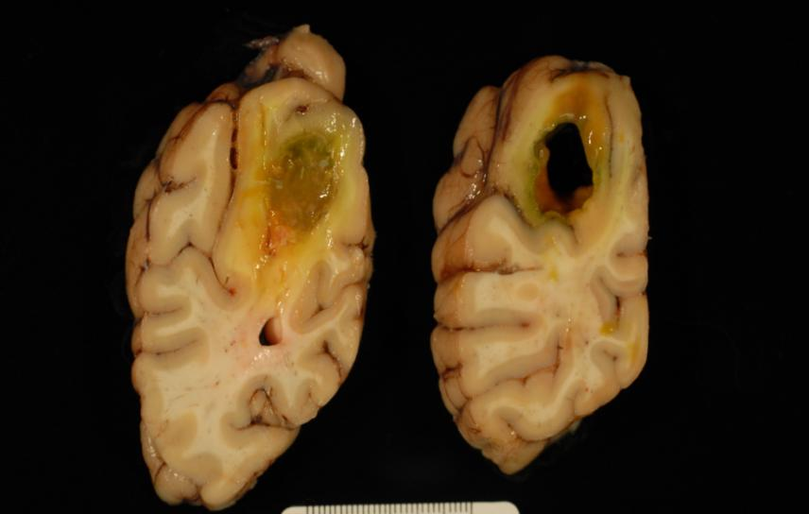
Progressive decline; hospice care
Final Neuropathological Diagnosis
I. Multifocal Aspergillus fumigatus (septate mold) brain abscesses
II. Yellow discoloration, dura mater, consistent with jaundice

Slide 45
Infections in bone marrow transplant recipients

Slide 46
Infections in Bone Marrow Transplant Patients
Indwelling device = CVC | Pre-engraftment < 30 days | Post-engraftment (30-100 days) | Late Phase > 100 days
Immune defect | neutropenia, mucositis, acute graft vs host disease | impaired cellular immunity; acute & chronic GVHD | impaired cellular and humoral immunity; chronic GVHD
 | Resp viruses | CMV | CMV; EBV including PTLD
 | HSV | CMV | CMV; EBV including PTLD
 | Facultative GNRs | (later) EBV PTLD | Community-acquired pneumonia
 | S. epidermidis | S. epidermidis | BK virus infection
 | Aspergillus | Aspergillus | UTI
 | Candidiasis | Candidiasis | Listeria, nocardia
 | GI streptococci | PJP
 | GI viruses | Strongyloides
 | HHV6 | Toxoplasmosis

Slide 47
Case
CC: neutropenic fever
16-year-old male was inpatient on the bone marrow transplant service. He had been diagnosed via bone-marrow biopsy of T-cell ALL with high-risk cytogenetics. He underwent induction chemotherapy, consolidation therapy then myeloablative umbilical cord transplant
On day 8 post transplant, he was neutropenic and developed fever of 39.1°C. BC were sent (negative), CT chest showed focal LLL pneumonia and he was treated with meropenem and continued on antifungal prophylaxis with micafungin and antiviral prophylaxis with acyclovir

Slide 48
Case
His fever improved, then the follow week (day +15) he developed recurrent neutropenic fever with elevated LFTs, headache and diffuse maculopapular rash. He had ongoing diarrhea.
Repeat CT chest showed improved LLL infiltrate

Slide 49
Approach the case
1) Is this patient’s new condition an infection?
2) What is your differential diagnosis?
Create the differential for an infection using pathogen type…
How would the timing in respect to his transplant affect the differential…
Bacteria
Virus
Fungus
Parasite
Pre-engraftment
Post-engraftment
Late

Slide 50
Work-up
Diagnostics:
CT head unremarkable
Repeat blood cultures negative
C. difficile PCR, rotavirus ag, cryptosporidium ag, giardia ag (neg)
1,3 Beta-D glucan level 31
Serum galactomannan 0.05
Serum CMV PCR neg
Serum EBV PCR neg
Serum HHV6 263,000 (prior week neg)
Skin biopsy: Purpura with sparse basal vacuolar degeneration; there are subtle signs of injury to the basal epidermis, and the differential includes early graft-vs-host disease, viral/drug exanthem, and eruption of lymphocyte recovery
Treatment started:
IV foscarnet (acyclovir prophylaxis discontinued)
Broad-spectrum antibiotics, prophylactic micafungin continued

Slide 51
Prevention of infections in transplant patients
Antimicrobials
During neutropenia early post-transplant: fungal agent with mold activity (i.e. posaconazole/voriconazole); trim/sulfa for PJP prophylaxis/toxo prophylaxis
CMV prophylaxis in select patients: valganciclovir
HSV prophylaxis if low risk for CMV: acyclovir
Immunizations
Before transplant if feasible
SCT patients will need revaccination after immune system reconstitution
No live vaccinations in immunocompromised patients

Slide 52
Summary
Review: types of immunity (innate, adaptive)
Application: clinical cases
Risk for opportunistic infections in AIDS, with glucocorticoids and other immunosuppressants such as biologics used in rheumatologic treatments
Timing and type of infection in solid organ transplant
Consider mold and CMV
Timing and type of infection in stem-cell transplant
Mold infections, respiratory and herpesviruses

Slide 53
Individual Readiness Assessment Test
Describe innate immunity.
Which cells proliferate in response to antigens?
You can expect a patient with a b-cell dysfunction to have poor response to what general pathogen type?
A patient with complement deficiency will have a poor response to what types of bacteria?
Most patients with PCP pneumonia present with fever and what other symptoms?
A patient with mild PCP pneumonia who is allergic to sulfa can be treated with what alternative?
List 3 differential diagnoses for an immunocompromised patient presenting with slowly progressive nodular skin lesions.
Late viral infections in solid organ transplant patients include:
What are immune features of the pre-engraftment phase of stem-cell transplant patients?
Humans are born with this defense that recognizes a few conserved structures present in organisms & can respond immediately or within hours of an antigen’s appearance
B and T lymphocytes
Bacteria
Encapsulated
Exertional dyspnea (over weeks) and non-productive cough
Clindamycin + primaquine
Histoplasmosis, cryptococcosis, coccidiomycosis, sporothrichosis, atypical Mycobacterial infection, nocardiosis
VZV, CMV, EBV, BK virus
Neutropenia, mucositis & acute graft vs host disease

