Slide 1
CNS Infections
Infectious Diseases Elective module

Slide 2
Overview
Definitions/recognition
Acute Meningitis
Pathogens:
Bacterial
Aseptic (viral), Aseptic (non-infectious – medications, etc.)
Other: fungal (sub-acute); eosinophilic
Diagnosis
Treatment/Adjunctive therapy
Encephalitis
Pathogens
Diagnosis
Treatment
CNS Abscess
Pathogens
Diagnosis
Treatment

Slide 3
Definitions
Meningitis: infection of the leptomeninges – including arachnoid mater and the CSF in both the subarachnoid space and cerebral ventricles
Aseptic meningitis: non-bacterial (most common = viral meningitis)
Encephalitis: infection of brain parenchyma; alteration of mental status > 24hrs with 2 or more of the following: fever, focal neuro deficit, seizure, CSF pleocytosis or abnormal imaging
Meningoencephalitis: cross-over between infection of the arachnoid/CSF and brain parenchyma with combined clinical features

Slide 4
Acute Bacterial Meningitis
Classic triad of fever, neck stiffness, and altered mental status in 50%
(All in 2 reviews had at least 1 sx and almost all present with 2/3 of above or HA)
Fever >95%, hypothermia less common; normal temp very rare
Symptoms present within hours to 1 – 2 days
May also present with:
Photophobia, seizures, focal neurologic deficits, petechiae, palpable purpura, arthritis, skin abscess or otitis
Petechial rash more commonly seen with meningococcal infection, but is non-specific
N Engl J Med. 2004;351(18):1849.
Ann Intern Med. 1998;129(11):862.
N Engl J Med. 1993;328

Slide 5
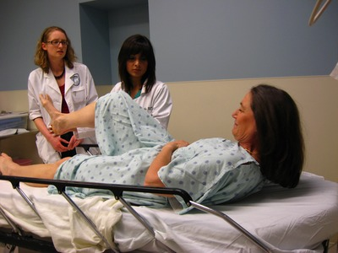
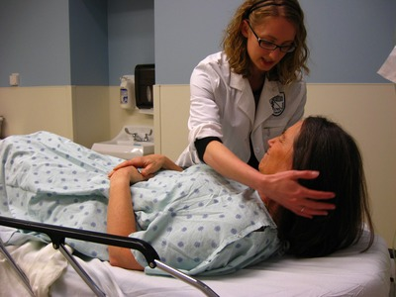
Physical Exam Techniques
*Helpful if + but low sensitivity
Kernig’s sign
Brudzinski’s sign
Lift leg towards chest: back pain and resistance to straightening: positive Kernig’s sign
Flex head towards chest: when patient flexes hips and knees: positive Brudzinski’s sign
Thomas KE, Hasbun R, Jekel J, Quagliarello VJ. The diagnostic accuracy of Kernig’s sign, Brudzinski’s sign, and nuchal rigidity in adults with suspected meningitis. Clin Infect Dis 2002; 35: 46–52.

Slide 6
Most Common Bacteria

Slide 7
Streptococcus pneumoniae
Most frequently observed etiologic agent of bacterial meningitis in the US
Patients often have contiguous or distant foci of pneumococcal infection (pneumonia, OM, mastoiditis, sinusitis, endocarditis)
Poor outcomes:
Mortality rate ~20%
High rate of neurologic sequela in survivors
Worse outcomes assoc. with: lower GCS score, cranial nerve palsies, raised ESR, CSF white blood cell count of <1000/mm³, high CSF protein concentration
van de Beek D, Brouwer MC, Koedel U, Wall EC. Community-acquired bacterial meningitis. Lancet. 2021 Sep 25;398(10306):1171-1183. doi: 10.1016/S0140-6736(21)00883-7. Epub 2021 Jul 22. PMID: 34303412.
Bennett, J.E. (2015) Principles and Practice of Infectious Diseases, 8th ed. Philidelphia, PA. Elsevier.

Slide 8
Neisseria meningitidis
Epidemiology:
2nd to S. pneumoniae in prevalence in US (in children and young adults)
Meningococci of serogroups Y then B account for most of the endemic disease in the United States (Menactra/Menveo = A, C, Y, W135)
MenB vaccine – Trumenba, Bexsero (now approved for use in same groups)
Pathogenesis:
Deficiency in terminal complement components (C5-C9, MAC), have markedly increased incidence of Neisseria infections
Outcomes – better than S. pneumo and Listeria - overall mortality rate of ~10%
van de Beek D, Brouwer MC, Koedel U, Wall EC. Community-acquired bacterial meningitis. Lancet. 2021 Sep 25;398(10306):1171-1183. doi: 10.1016/S0140-6736(21)00883-7. Epub 2021 Jul 22. PMID: 34303412.
Bennett, J.E. (2015) Principles and Practice of Infectious Diseases, 8th ed. Philidelphia, PA. Elsevier.

Slide 9
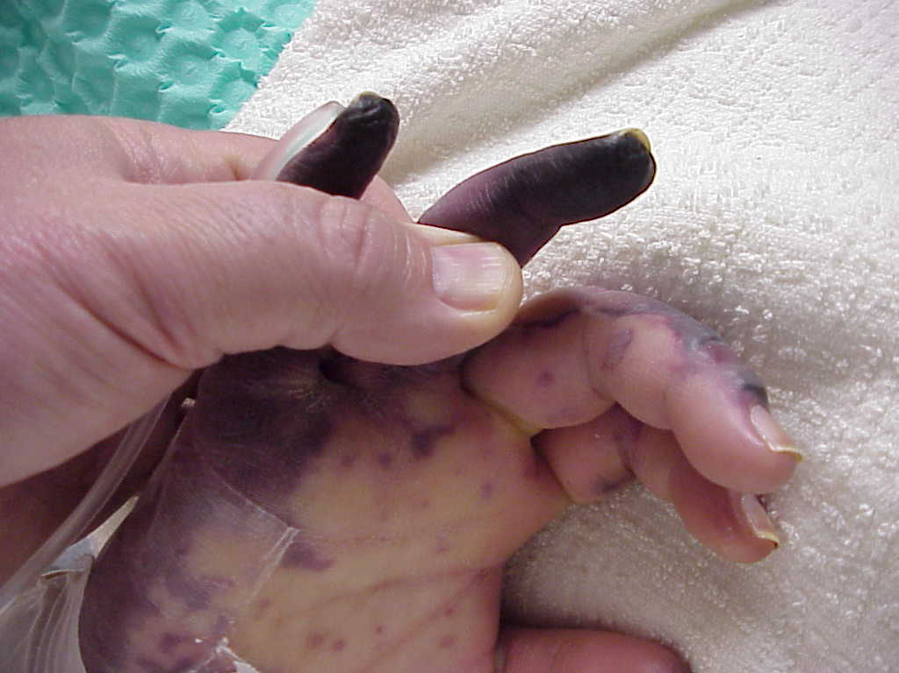
40 hours after presentation - digital gangrene

Slide 10
Haemophilus influenzae
Epidemiology:
Previously isolated in nearly half of all cases of bacterial meningitis in US, now dramatically down owing to immunization practices (Hib)
Overall mortality rate is 5%
Isolation of this organism in older children/adults should alarm you to underlying conditions including:
Sinusitis, otitis media, epiglottitis, pneumonia, head trauma with CSF leak
Diabetes mellitus, alcoholism, splenectomy or asplenic states,, and immune deficiency (e.g., hypogammaglobulinemia)
van de Beek D, Brouwer MC, Koedel U, Wall EC. Community-acquired bacterial meningitis. Lancet. 2021 Sep 25;398(10306):1171-1183. doi: 10.1016/S0140-6736(21)00883-7. Epub 2021 Jul 22. PMID: 34303412.
Bennett, J.E. (2015) Principles and Practice of Infectious Diseases, 8th ed. Philidelphia, PA. Elsevier.

Slide 11
Listeria monocytogenes
Epidemiology
Causes <5% of cases of bacterial meningitis in the US
Most common in infants <1 month (up to 10% of cases), adults >60 years, alcoholics, cancer patients, those receiving corticosteroid therapy, and immunosuppressed adults (not particularly HIV)
Pregnant women account for 25% of all cases of listeriosis & may harbor the organism asymptomatically and transmit the infection to infants at birth
CSF can have high relative lymphocytosis and gram stain can be negative so have a high index of suspicion based on history
Outcomes
Mortality rate of 15 – 20%
van de Beek D, Brouwer MC, Koedel U, Wall EC. Community-acquired bacterial meningitis. Lancet. 2021 Sep 25;398(10306):1171-1183. doi: 10.1016/S0140-6736(21)00883-7. Epub 2021 Jul 22. PMID: 34303412.
Bennett, J.E. (2015) Principles and Practice of Infectious Diseases, 8th ed. Philidelphia, PA. Elsevier.

Slide 12
CSF Findings
CSF | Appearance | OP | WBC | Cell type | Gluc | Prot | CSF Lactate
Normal | clear | 7-20 Cm H20 | 0-5 | N/A | >45 | <45 | <3.5
Bacterial | cloudy | ↑ | 1000-5000 | PMNs | <40 | 100-500 | >3.5
TB | nml/cloudy | ↑ | 50-300 | Monos | <45 | 50-300 | +/-
Cryptococcal | nml/cloudy | nml / ↑ | 20-500 | Monos | <40 | >45 | <3.5
Viral | clear | nml / ↑ | 50-1000 | Lymph/ monos | nml | <200 | <3.5
Parasitic | cloudy | nml / ↑ | 150-2000 | Eosin (>10%) | nml | >45 | <3.5

Slide 13
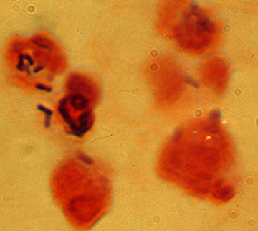
Q) A 51-yo woman presents to the ED with a several day history of fever, HA and new mental status changes. Gram stain of the CSF is shown to the right. What is the likely pathogen?
Klebsiella pneumoniae
Listeria monocytogenes
Neisseria meningitidis
Streptococcus pneumoniae

Slide 14
Hint: Gram Stains
Purple = gram-positive
Pink = gram negative (‘only girls can wear pink’ is a negative stereotype)
= rod
= cocci

Slide 15
Case example
CC: fever & confusion
72-year-old man presents to the ED. His friend called EMS when he found him at his apartment on his couch, confused about the day, sweating, with fever
ROS positive for: HA, nausea but no other specific symptoms
PMHx: HLD, HTN, tobacco use, COPD (no home O2 requirement)
Temp in ED: 102°F, 02 sat 94% RA

Slide 16
What is the most likely pathogen?
CSF
Protein – 165
Gluc 18 (serum 89)
RBC 58
WBC 2315
76% neutrophils
24% lymphs
Enterovirus meningitis
Group B streptococcus meningitis
K. pneumoniae meningitis
L. monocytogenes meningitis
S. pneumoniae meningitis

Slide 17
Hint:
HA, fever and confusion = CNS infection
Very high CSF WBC with neutrophil predominance and low glucose = bacterial meningitis
No specific risk factors mentioned and strep is most common, so most likely strep

Slide 18
CT head Indications
Should we have done a CT head on our last patient prior to the LP?
No, unless:
Immunocompromised
Altered consciousness
New seizure
Known CNS disease
Papilledema
Focal neurologic deficit
Hasbun R et al. N Engl J Med 2001;345:1727-1733

Slide 19
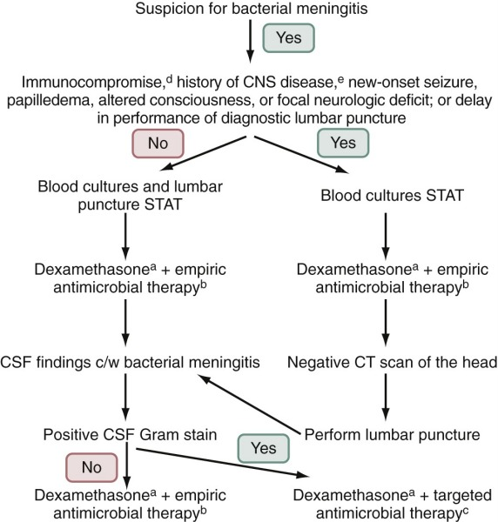
Bennett, J.E. (2015) Principles and Practice of Infectious Diseases, 8th ed. Philidelphia, PA. Elsevier.

Slide 20
Adjunctive Steroids in Bacterial Meningitis
If suspected S. pneumo meningitis/presumed bacterial meningitis, give dexamethasone 15 - 20 minutes before or at the time of antibiotic administration
(0.15 mg/kg every six hours for four days)
Do not give to neonates or adults who have already received antimicrobial therapy (unlikely to improve outcomes); also less likely of benefit in developing world or w/sig delayed presentation
Discontinue if proven L. monocytogenes
van de Beek D, Brouwer MC, Koedel U, Wall EC. Community-acquired bacterial meningitis. Lancet. 2021 Sep 25;398(10306):1171-1183. doi: 10.1016/S0140-6736(21)00883-7. Epub 2021 Jul 22. PMID: 34303412.

Slide 21
Acute Viral Meningitis
Viruses = major cause of aseptic meningitis (any meningitis (infectious or noninfectious), particularly one with a lymphocytic pleocytosis, for which a cause is not apparent after initial evaluation on routine stains and cultures of CSF)
Clinical features: usually sudden
Fever (76% - 100%) may be biphasic illness
Headache (often severe and frontal) is nearly always present in adults
>50% have nuchal rigidity
Photophobia
Nonspecific symptoms and signs: vomiting, anorexia, rash, diarrhea, cough, upper respiratory findings (especially pharyngitis), and myalgias
May be assoc w/ myopericarditis, conjunctivitis, pleurodynia, herpangina, hand-foot-and-mouth disease
Bennett, J.E. (2015) Principles and Practice of Infectious Diseases, 8th ed. Philidelphia, PA. Elsevier.

Slide 22
Enteroviruses
Leading recognizable cause of aseptic meningitis syndrome, accounts for ~90% of all pediatric cases in which a pathogen is identified (most common in adults as well)
Most common viral meningitis worldwide
In temperate climates, they appear with a marked summer/fall seasonality
In healthy hosts; associated w/rituximab
Diagnosed with CSF PCR
Bennett, J.E. (2015) Principles and Practice of Infectious Diseases, 8th ed. Philidelphia, PA. Elsevier.

Slide 23
Other Viral Meningitis
HSV 1 and 2
HSV accounts for 0.5% - 3% of all cases of aseptic meningitis
HSV meningitis, much less severe (self-limited syndrome) compared to HSV encephalitis
Most commonly associated with primary genital infection (36% of women and 13% of men with HSV-2); recurring HSV-2 = Mollaret’s meningitis
VZV w/ or w/o skin lesions
Mumps (meningitis can occur any time in course – could have parotitis and/or orchitis)
Primary HIV (could be only symptom of acute retroviral syndrome)
CMV/EBV possible along with mono (rare)
Arboviruses mainly implicated in encephalitis

Slide 24
Case 3
CC: Fever with HA
29-year-old man who works in sales presents to the ED with fever of 101-102°F for 24 hours, anorexia, nausea, fatigue
Severe headache “all over” and light seems to make it worse.
Denies history of similar headaches and there is no family history of migraines
Exam demonstrates meningismus

Slide 25
What’s the most likely diagnosis?
CSF
Gluc 57 (serum 115)
Protein 26
RBC 21
WBC 108
38% neutrophils
42 % lymphs
20% monos
CMV meningitis
Enterovirus meningitis
H. influenzae meningitis
HSV encephalitis
N. meningitidis meningitis

Slide 26
Hint:
HA, fever and meningismus = meningitis
Slightly elevated CSF WBC with lymph predominance and normal glucose = aseptic meningitis
Most common cause = Enteroviruses

Slide 27
Encephalitis

Slide 28
HSV Encephalitis
Most common fatal viral encephalitis worldwide (10-20% of the viral encephalitis cases in US)
No seasonal predilection, reactivation of latent virus
All age groups, though Caucasians >95% of all biopsy proven disease
Mostly HSV-1 (HSV-2 more common for meningitis in adults and encephalitis in neonates)
AMS, decreased consciousness, fever, seizures, personality changes
Focal neurologic deficits
Diagnosis:
CSF: WBC mean 100 cells/mm3, lymph predominance. protein elevated to mean of 100, can have increased RBC if extensive necrosis
CSF HSV PCR 98 % sensitive, 99% specific for diagnosis
Most severe of all human viral CNS infections >70% mortality without therapy
Treatment = IV acyclovir – start as soon as you consider this diagnosis
Betts RF Chapman SW, Penn R. A Practical Approach to Infectious Diseases, 5th ed. 2003

Slide 29
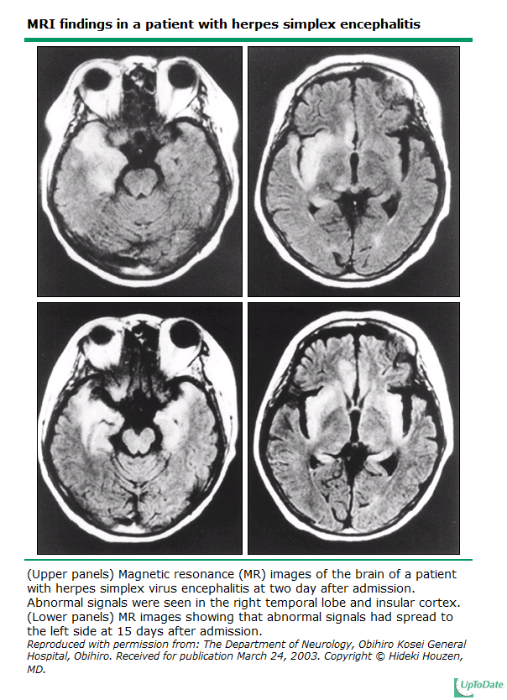
MRI w/contrast shows signal enhancement in predominately temporal lobes, with asymmetric involvement
Day 2
Day 15

Slide 30
Other Encephalitis Etiologies
VZV
Typically presents with delirium after vesicles
Don’t have to have a rash or shingles!
HA, fever, vomiting, seizures, focal neurologic deficits, cerebral ataxia
Diagnosis: CSF: mild elevated WBC ct, lymph predominance, mild protein elevation
CSF VZV PCR
Treatment = IV acyclovir
Enteroviruses: also cause encephalitis, can also have a rash
MUCH less common:
HIV, EBV, CMV, Rabies
Arthropod associated: WNV, St. Louis encephalitis, Japanese encephalitis, Eastern and Western equine encephalitis, La Crosse encephalitis, California encephalitis
Betts RF Chapman SW, Penn R. A Practical Approach to Infectious Diseases, 5th ed. 2003

Slide 31
West Nile Virus: neuroinvasive disease
Encephalitis-meningoencephalitis (60%)
Meningitis (30-40%)
Clinical features:
Fever (>90%)
Rash-‘minority’ of patients; macular, papular, morbilliform
Weakness - 10% in New York outbreak had complete flaccid paralysis
Distinguish from Guillain-Barre (EMG/NCV –axonal (most prominent) and demyelinating lesions
Diagnosis:
Preferred: IgM in CSF
Also: Serum serology available
Treatment
Supportive
Ann Intern Med 2002;137:173

Slide 32
Brain Abscess

Slide 33
Brain Abscess
Focal, intracerebral infection that begins as a localized area of cerebritis and develops into a collection of pus surrounded by a well-vascularized capsule
Direct spread 20-60% of cases; remainder bacteremic/hematogenous spread
Overall mortality ~ 8% to 25%
Epidemiology:
Bacterial
Fungal
Protozoan

Slide 34
Bacterial Brain Abscess
Streptococci (aerobic, anaerobic, and microaerophilic) including S. anginosis (milleri) group are most commonly isolated bacteria (70% of cases)
Frequently isolated in mixed infections (30% to 60% of cases)
Bacteroides and Prevotella spp., isolated in 20% to 40% of patients
Frequently found in mixed infections
Enteric gram-negative bacilli (Proteus spp., Escherichia coli, Klebsiella spp., and Pseudomonas spp.) are isolated in 23% to 33% of patients; often in patients with otic foci, with sepsis, who have had neurosurgical procedures, or immunocompromised
Staphylococcus aureus -10% to 20% of isolates, usually in patients with cranial trauma or infective endocarditis – often single agent
Bennett, J.E. (2015) Principles and Practice of Infectious Diseases, 8th ed. Philidelphia, PA. Elsevier.

Slide 35
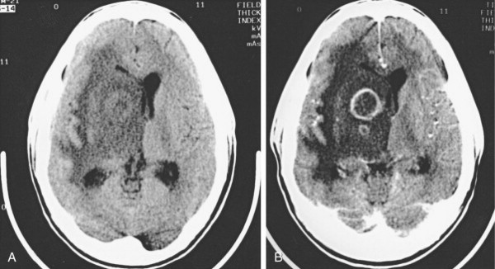
Diagnosis – Neuroimaging
CT characteristic appearance is a hypodense center with a peripheral uniform ring enhancement after the injection of contrast material

Slide 36
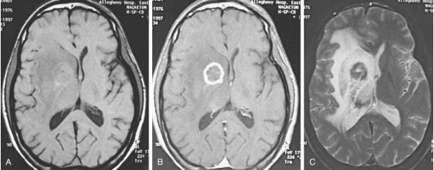
Diagnosis – Neuroimaging
MRI - more sensitive than CT; greater contrast between cerebral edema and adjacent brain, more conspicuous spread of inflammation into ventricles and subarachnoid space, and earlier detection of satellite lesions
Bennett, J.E. (2015) Principles and Practice of Infectious Diseases, 8th ed. Philidelphia, PA. Elsevier.

Slide 37
Diagnosis
Image-guided aspiration
For gram stain & culture
Special stains, such as acid-fast & modified acid-fast stains (for Nocardia), mucicarmine, methenamine silver for fungi
16S rRNA gene sequencing and amplification w/negative culture results
Tissue: histopath for fungi, pseudocysts and tachyzoites (toxoplasma)
CSF: cultures; CSF Toxoplasma PCR has a specificity of 96% to 100%, but a sensitivity of only about 50%
Serum: blood culture, Toxoplasma serologies

Slide 38
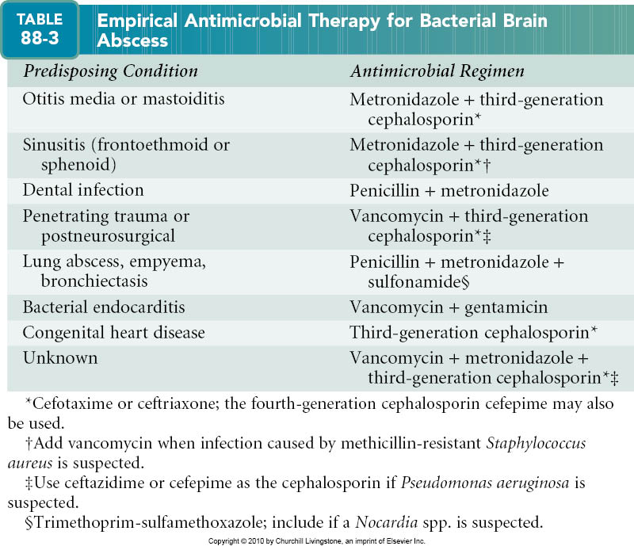
Bennett, J.E. (2015) Principles and Practice of Infectious Diseases, 8th ed. Philidelphia, PA. Elsevier.

Slide 39
CNS Infection Clues
Clue (s) | Pathogen
Otitis media + CNS infection | S. pneumoniae
Diabetic patient with meningitis | Group B strep
Pregnant + CNS infection | Listeria
Aspenia/functional aspenia | Encapsulated organisms (S. pneumo, Neisseria, Hib)
Encephalitis with orchitis or parotitis | Mumps
Penetrating trauma / CNS infection after neurosurgery | S. aureus (or enteric gram-negative organism)
Subacute meningitis in HIV | Cryptococcus
Asymmetric flaccid paralysis | West Nile Virus
Temporal lobe enhancement | HSV-1 encephalitis

Slide 40
Key points
Define the condition:
Meningitis
Encephalitis
Meningoencephalitis
Other CNS infection
Rapid Triage post-imaging (if needed) and LP
Bacterial? What other tests should I order?
Treatment
Antibiotics
Supportive care

Slide 41
Individual Readiness Assurance Test
What is meningoencephalitis?
Most patients with acute bacterial meningitis present with which 3 symptoms?
When you flex a meningitis patient’s neck on exam, they reflexively flex at their hips. This would be a + _____ test?
What is the recommended antibiotic for N. meningitidis meningitis?
What patient immune factors can pose a risk for H. influenzae meningitis?
In TB meningitis, CSF glucose will typically be high, low or normal?
A patient presents with altered mental status and fever. A CSF HSV PCR is negative. Do you trust this result?
How does a brain abscess usually show up on contrasted CT head?
A cross-over between infection of the arachnoid/CSF and brain parenchyma with combined clinical features
Fever, neck stiffness, and altered mental status
Brudzinski’s
Ceftriaxone (or cefotaxime)
Splenectomy, hypogammaglobulinemia
Low
Typically. CSF HSV PCR 98% sensitive, 99% specific for diagnosis
Lesion with a hypodense center with a peripheral uniform ring enhancement after injection of contrast

