Slide 1
Osteomyelitis
Infectious Diseases Elective module

Slide 2
Overview
Osteomyelitis-related definitions
Hematogenous osteomyelitis
Contiguous osteomyelitis
Diabetic foot ulcer →osteomyelitis
Prosthetic joint infection
Vertebral osteomyelitis
Buzzwords

Slide 3
Osteomyelitis definitions
Classification Schemes based on…
Duration (acute/chronic)
Pathogenesis
Location
Extent
Host status
Hematogenous: seeding from bloodstream infection: risk increases with age as well as with IV drug use, SBE, DJD/spine surgery and DM/immunosuppression
Contiguous: direct spread from skin/soft tissue infection
Direct introduction: secondary to penetrating trauma or surgery

Slide 4
Hematogenous
Hematogenous: seeding from bloodstream infection ~20% adult cases (more common in children)
Higher risk in those at risk for bloodstream infection generally (hemodialysis with indwelling catheter/other long-term catheters, IV drug use, endocarditis, sickle cell disease)
Also in those with distant foci of infection (skin infection, UTI, GI infection)
Most common site is intervertebral disk→ adjacent vertebral bodies (kids also affected in long bones/growth plates)
Typically 1 organism
Typically S. aureus (40-60% cases)
IVDA: Sternoclavicular joint and sacroiliac joint

Slide 5
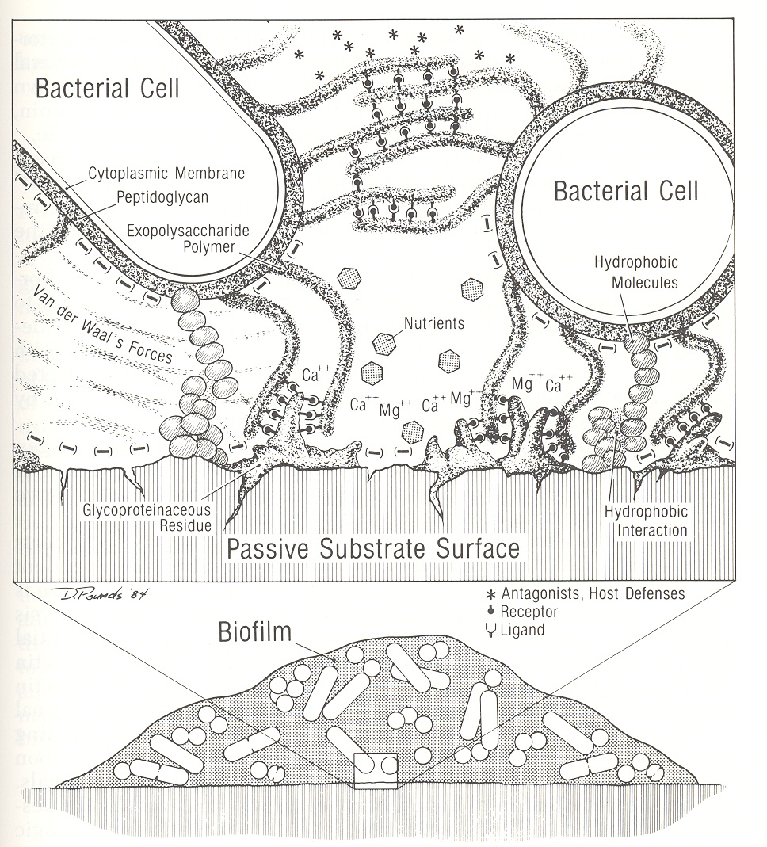
Pathogenesis
1. Bacterial cells adhere to damaged bone or foreign body (prosthetic joint) via glycoprotein residue & hydrophobic interaction
“Glue” includes fibrin, platelets & fibronectin
2. Bacteria aggregate within this glue “extensive polymer matrix” they aid in forming
3. Extracellular toxins and bacterial antigens recruit additional immune cells and their enzymes degrade bone collagen/elastin
4. This “pus” spreads into vascular channels reducing pH, blood flow and leading to ischemia
5. Creates devitalized bone leading to opportunity for additional bacterial replication

Slide 6
Osteomyelitis: signs and symptoms
Pain, dull then worsening at site of infection
May have fever, sweats, fatigue (generalized sign of systemic infection)
Localized erythema, edema, tenderness
Pain with palpation of the affected vertebral body (should have a high index of suspicion for discitis/vertebral osteomyelitis in patient with S. aureus bacteremia with new/worsening back pain)
Draining sinus tract is a pathognomonic sign for chronic osteomyelitis of the bone

Slide 7
Contiguous
Contiguous: direct spread from soft tissue infection – MUCH more common in adults > 50
Diabetes, vascular disease are common comorbidities/risks
Tends to be polymicrobial – S. aureus, coag neg staph but may also include streptococci, enterococci, GNRs (PSAE, E. coli, Enterobacter, Serratia and anaerobes (Peptostreptococcius, Bacteroides, Clostridium spp.)

Slide 8
Signs and symptoms
Pain at site of infection (or in case of diabetic neuropathy may be insensate)
Rare to have sign of systemic infection
Bone visible in wound/wound probing to bone is usually diagnostic for osteomyelitis
Foot ulcerations present > 2 weeks or > 2 cm are correlated to osteomyelitis but will need diagnostic testing for confirmation

Slide 9
Diagnosis
ESR is often elevated but a normal ESR dose not exclude possibility of osteomyelitis
Blood cultures in all cases of proposed hematogenous osteomyelitis and in those with systemic symptoms/sepsis
Imaging:
MRI has highest sensitivity and value in delineating bone anatomy
3 phase bone scan is a potentially useful nuclear modality if MRI is not feasible
CT can be useful in delineating bone anatomy and adjacent soft tissue and is a reasonable alternative if above are not feasible; 2nd to MRI for diagnosing vertebral osteomyelitis
Xray changes often take at least 2 weeks to show up in setting of disease, very low sensitivity. If present, may see periosteal elevation, cortical loss

Slide 10
Diagnosis
Gold standard: bone biopsy for surgical pathology and bone cultures
With exception of S. aureus, cultures taken from superficial wounds or sinus tracts correlate poorly to culture from bone itself
Diagnosis:
1. Histological evidence of inflammation and osteonecrosis
2. Isolation of the organism from bone
-Exception - Hematogenous osteomyelitis
-Blood cultures & radiographic evidence of osteomyelitis may be sufficient

Slide 11
3-phase bone scan
Uses ^{99m}Tc methylene disphosphonate (MDP)
Mechanism:
absorbs on crystal surfaces
binds to organic matrix
Is preferentially incorporated into metabolically active bone
Phase
1 - blood flow to area
2 - pooling of blood (degree of inflammation)
3 - pathogenic bone (DJD, healing fx, osteo) = cannot reliably discern between infection, neoplasm & trauma

Slide 12
Case 1
CC: foot wound(s)
70-year-old female admitted from clinic
R foot ulcers, stable but L heel ulcer progressive over 5 months, drainage increased x 1 month
No fever, chills, night sweats or other new systemic symptoms

Slide 13
Case 1
PMHx:
Endometrial cancer, prior hysterectomy
DM (diabetes mellitus) complicated by neuropathy and DM foot ulcerations
Cardiomyopathy
Hypertension
Hypothyroidism
Social history: nonsmoker, no ETOH or rec drug use, no recent new exposures
Medications: carvedilol, bumetanide, insulin glargine and aspart, synthroid, magnesium oxide
ROS: otherwise unremarkable

Slide 14
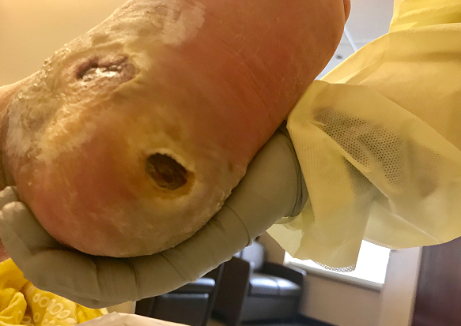
Physical Examination
Vital Signs: T= 36.7C BP= 118/76 P=72 Resp= 18
Gen: alert, oriented, no distress
Lungs: clear bilaterally with diminished breath sounds in bases
CV: Regular, soft systolic murmur
L foot as pictured below, cannot see/probe bone
WBC: normal
ESR: 67

Slide 15
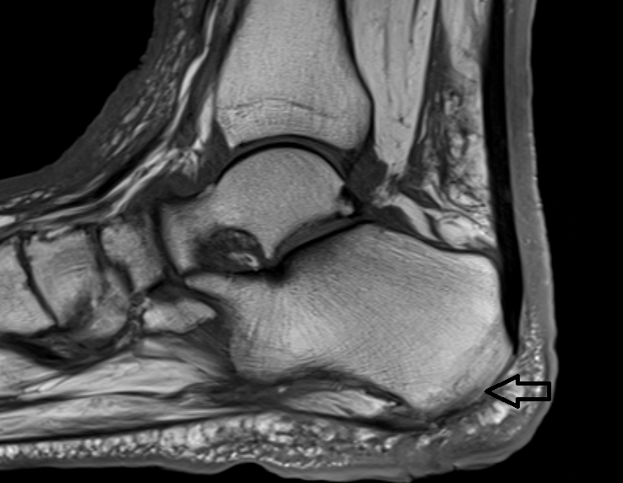
MRI cortical irregularity

Slide 16
Treatment
Hematogenous: parenteral antibiotic therapy
Children: no surgery
Adults: sometimes need surgical debridement (i.e. vertebral osteomyelitis with discitis and associated epidural abscess)
Contiguous: need surgical debridement
Usually parenteral antibiotic therapy as an adjunct to surgical debridement of devitalized tissues
Can transition to oral therapy if pathogen is susceptible to an antimicrobial that is highly bioavailable with good bone concentrations (fluoroquinolones, metronidazole, fluconazole, clindamycin)
Antimicrobial therapy duration is usually 6 weeks
Usually broad spectrum and directed to bone/deep tissue culture
If “good” culture not avail, coverage for streptococci, gram negatives and anaerobes

Slide 17
Adjunctive treatment
Glycemic control in diabetic patients
Revascularization in setting of peripheral vascular disease
Aggressive wound care therapy, potentially negative pressure (wound vac) therapy
Management of lower extremity edema with leg elevation, compression stockings in some cases
Hyperbaric oxygen therapy (data are limited)

Slide 18
Case 2
CC: incision drainage
55-year-old man presents with drainage from a pin-hole wound
History of osteoarthritis right knee, status post total knee replacement 2 years ago
Denies history of infection around the time of initial surgery and had complete wound healing
Pain in right knee x 2 weeks, now drainage (serous) from a small “hole” mid incision

Slide 19
Case 2
PMHx:
Hypertension
Hyperlipidemia
Social history: nonsmoker, no ETOH or rec drug use, no recent travel, no pets
*Notes recently climbing up and down a ladder frequently as repainting a screened-in porch but doesn’t recall trauma to his knee
Medications: lisinopril, simvastatin
ROS: night sweats a few times in the past week, otherwise negative

Slide 20
Physical Examination
Vital Signs: T= 37.9°C BP= 126/69 P=70 Resp= 18
Gen: alert, oriented, no distress
Lungs: clear bilaterally
CV: Regular, no murmur
Right lower extremity: right knee warm to touch with pin-hole mid-incision with serous drainage
WBC: 11.5
ESR: 50
CRP 11mg/dL
Plain film R knee: no periprosthetic fracture, mild loosening about the prosthesis

Slide 21
Prosthetic joint infections
Mechanism of infection can still be hematogenous, contiguous or from surgery
Signs and symptoms:
New pain in a site of prior joint surgery/joint replacement
Fever, chills, night sweats or other systemic symptoms in patient at risk for bloodstream infection (and subsequent seeding of joint)
Loosening of hardware in the first 2 years post-replacement
Biofilm plays a large role in how infection can remain “latent” for some time and persistent

Slide 22
Biofilm
EPS – extracellular polymeric substances
Center for Biofilm Engineering – Montana State University

Slide 23
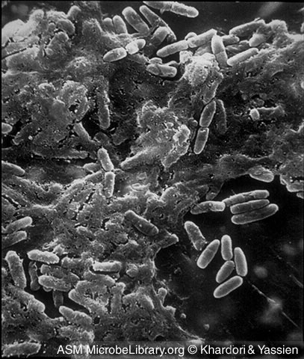
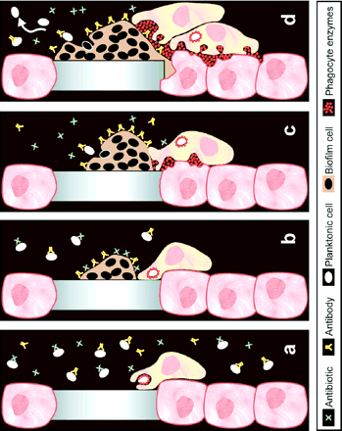
Why are antimicrobials unsuccessful in treating organisms in biofilm?
Resistance to phagocytosis
Slowed metabolism of pathogens within biofilm (sessile organisms)
Decreased penetration of some antimicrobials into biofilm
Some studies suggest ↓ diffusion of certain, but not all antibiotics
In prosthetic infections, ALL foreign material (prosthetic, cement, devices, wires) must be removed or infection may return, if all cannot be removed, chronic suppression is considered

Slide 24
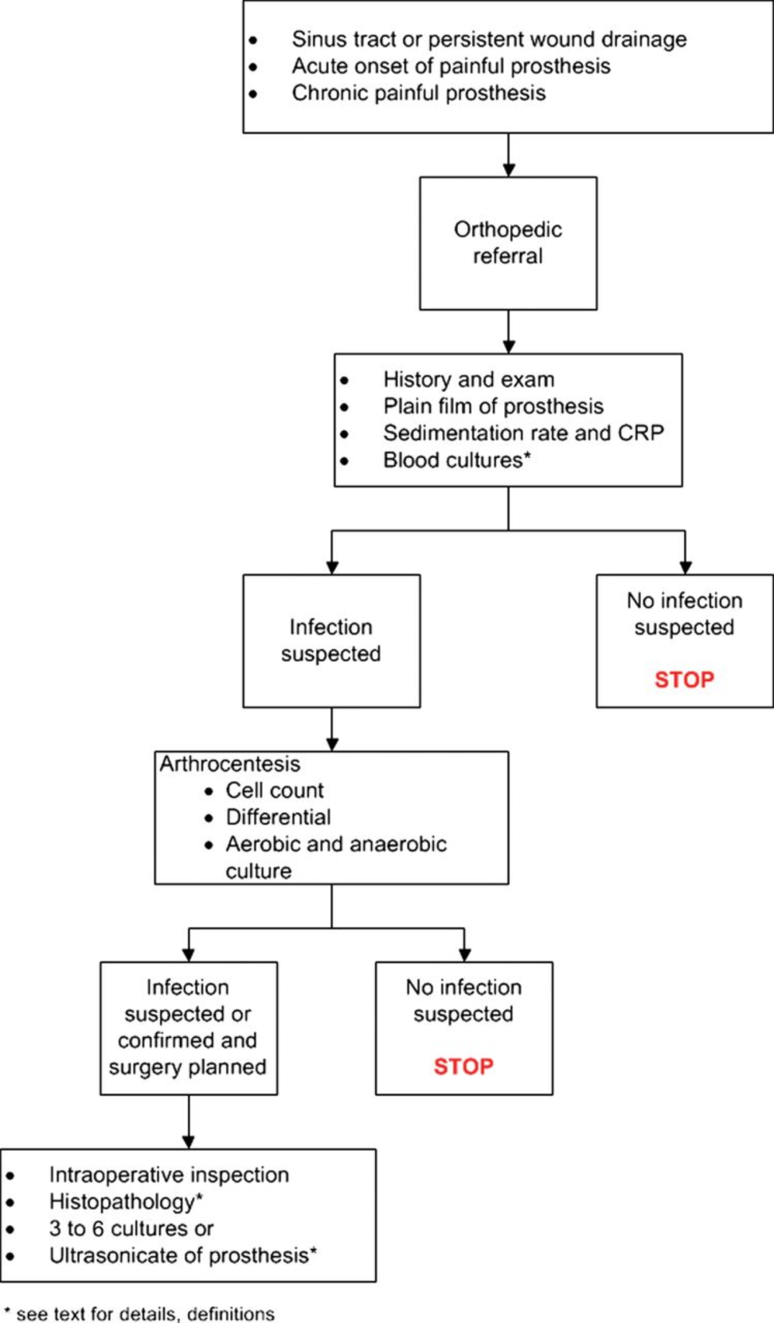
Diagnosis and Management of Prosthetic Joint Infection: Clinical Practice Guidelines by the Infectious Diseases Society of Americaª
Clin Infect Dis. 2012;56(1):e1-e25. doi:10.1093/cid/cis803
Clin Infect Dis | © The Author 2012. Published by Oxford University Press on behalf of the Infectious Diseases Society of America. All rights reserved. For Permissions, please e-mail: journals.permissions@oup.com.
Notes:
Figure 1. Preoperative and intraoperative diagnosis of prosthetic joint infection. Abbrevation: CRP, C-reactive protein.
24

Slide 25
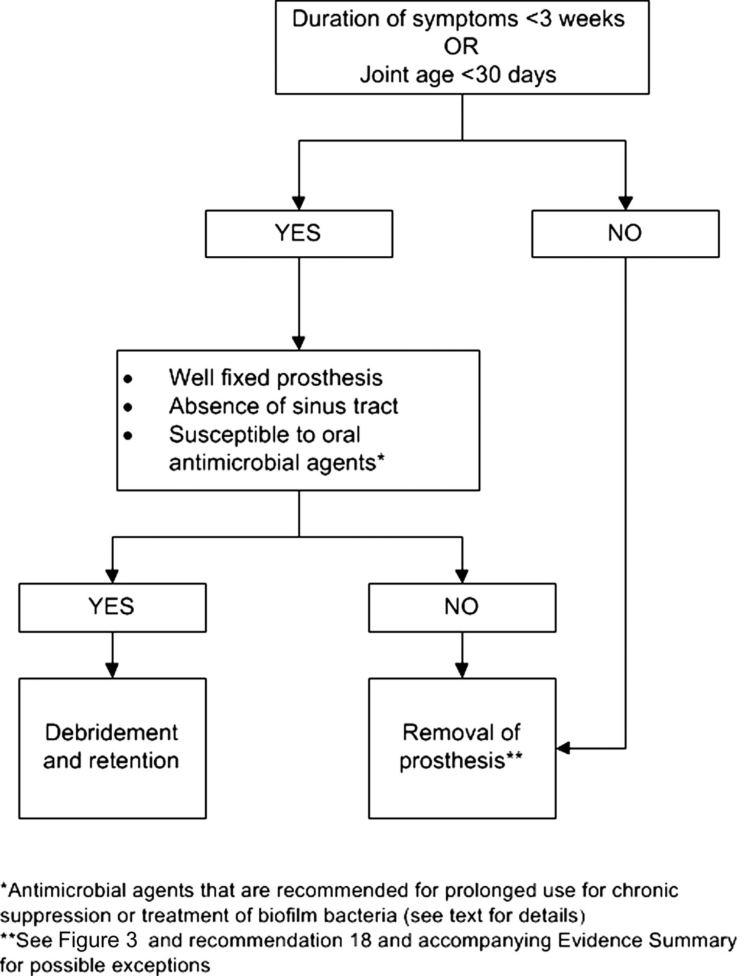
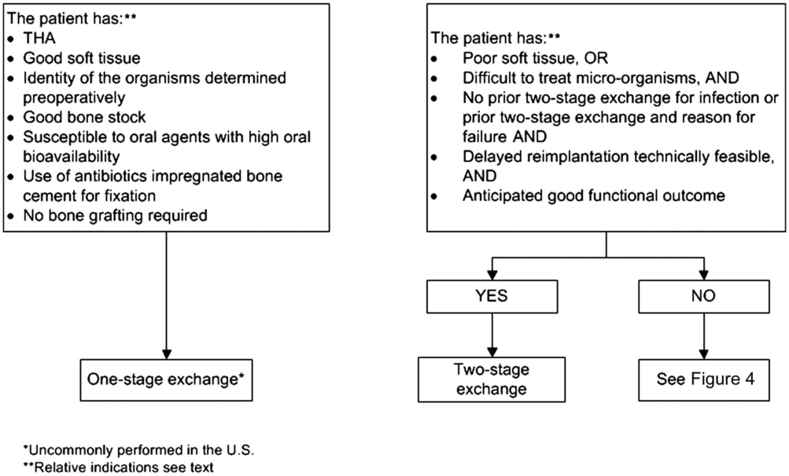
Diagnosis and Management of Prosthetic Joint Infection: Clinical Practice Guidelines by the Infectious Diseases Society of Americaª
Clin Infect Dis. 2012;56(1):e1-e25. doi:10.1093/cid/cis803
Clin Infect Dis | © The Author 2012. Published by Oxford University Press on behalf of the Infectious Diseases Society of America. All rights reserved. For Permissions, please e-mail: journals.permissions@oup.com.
Notes:
Figure 2. Management of prosthetic joint infection.
25

Slide 26
Treatment of prosthetic joint infection
Directed at the pathogen(s) recovered
Usually parenteral (IV)
For staphylococcal PJI in which the implant is retained, rifampin used as an adjunct to therapy as it is active against biofilm
Never use rifampin alone to treat staphylococcal infections – organism quickly becomes resistant
Antimicrobial therapy duration is usually 6 weeks

Slide 27
Case 3
CC: fever and back pain
42-year-old female presents with temp of 38.6°C, chills and back pain for 3 days
History of IV methamphetamine use and no other medical problems

Slide 28
Physical Examination
Vital Signs: T= 38.7°C BP= 110/70 P=102 Resp= 20
Gen: alert, oriented, anxious
Lungs: clear bilaterally
CV: Regular, soft systolic murmur
Abd: benign
Back: tenderness to palpation around L3-4 vertebral body
Skin: track marks antecubital fossa bl, no other rash
WBC: 13.5
ESR: 87
CRP 15.5 mg/dL
Blood cultures: S. aureus x 2 sets

Slide 29
MRI

Slide 30
Vertebral osteomyelitis
Mechanism usually hematogenous (seeding of disk = spondylodiskitis) and then infects associated vertebral body
Can also be direct inoculation from spine surgery or epidural injection
Lumbar spine > thoracic > cervical
S. aureus is most common pathogen
Signs and symptoms:
Fever (50%), chills, night sweats or other systemic symptoms in patient at risk for bloodstream infection (and subsequent seeding of joint)
New onset or worsening of chronic localized back pain
Watch for radicular pain, neurologic symptoms

Slide 31
Diagnosis
WBC often normal
ESR is often elevated (can be >100) and CRP elevated in 80% patients; but normal values do not exclude possibility of disease
Blood cultures are necessary and positive in about 50% of patients
Imaging:
MRI has highest sensitivity, can be false positive in uninfected vertebral body fracture
Gallium scan may be helpful
CT-guided biopsy for pathology and culture is recommended unless blood cultures are positive
2nd biopsy is rec if first non-diagnostic and infection is still considered likely

Slide 32
Treatment
Usually parenteral and guided by isolated pathogen
Antimicrobial therapy duration is usually 6-8 weeks
Repeat imaging should be reserved for patients failing to show clinical and or laboratory improvement as changes on MRI can be evident for months
Some patients may need surgical debridement and/or spinal stabilization during/after a course of antimicrobial therapy
Indications for surgery:
Neurologic deficits or symptoms of spinal cord compression
Progression or recurrence despite “proper” antimicrobial therapy

Slide 33
Buzz words

Slide 34
Summary
Osteomyelitis in adults often contiguous – need cultures of bone and adequate debridement for treatment success
Hematogenous osteomyelitis in adults is often S. aureus – eval for other foci of infection/SBE
Prosthetic joint infections are complex; if not all foreign material are removed cure will be difficult
Consider buzzwords (common associations) in a standardized test question that involves osteomyelitis

Slide 35
Individual Readiness Assessment Test
Which type of osteomyelitis involves seeding from the bloodstream?
What is the most common pathogen in hematogenous/vertebral osteomyelitis in osteomyelitis?
Diabetic foot ulcers are more likely to lead to osteomyelitis once they are present > how many weeks?
What is the gold standard for diagnosis of osteomyelitis?
What feature on exam is pathognomonic for prosthetic joint infection (with associated osteomyelitis)
A plain film is non-diagnostic for osteomyelitis in a patient with a DM-foot ulcer present >1 month. What imaging modality would you recommend next, as it has the highest sensitivity?
How long would a patient with Staphylococcus vertebral osteomyelitis/associated discitis typically be treated with antibiotic therapy?
A patient presents with osteomyelitis of the ulna after wound from a cat bite. What pathogen would you be concerned about?
hematogenous
S. aureus
2 weeks
bone biopsy for surgical pathology and bone cultures
sinus tract
MRI
6-8 weeks
Pasteurella multocida

